Slide 1

Group Project Part 2
Presented By:
Dipen Patel
Mahesh Kate
Mohammed Sahil Fnu
Karan Gaikwad
Sri Ram Fnu

Slide 2
Model: Deep Learning
Presented By:
Dipen Patel

Slide 3
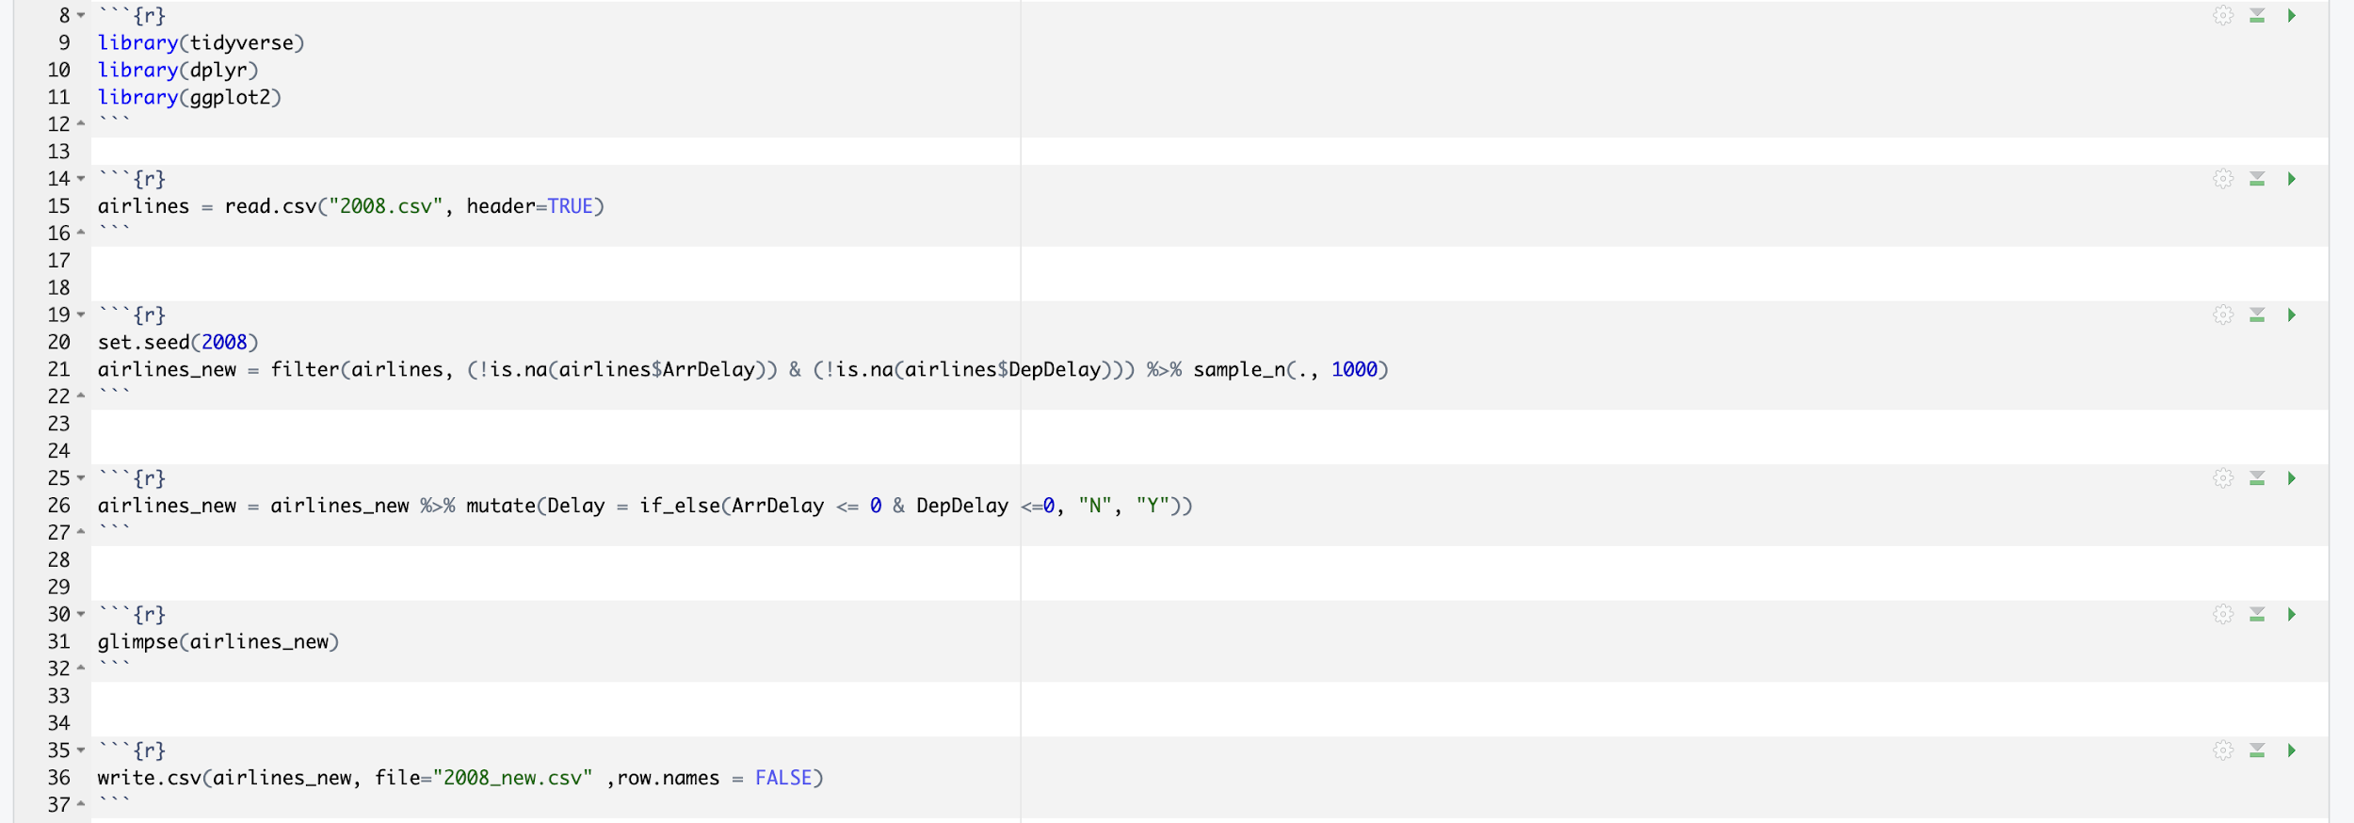
Creating Random Sample

Slide 4
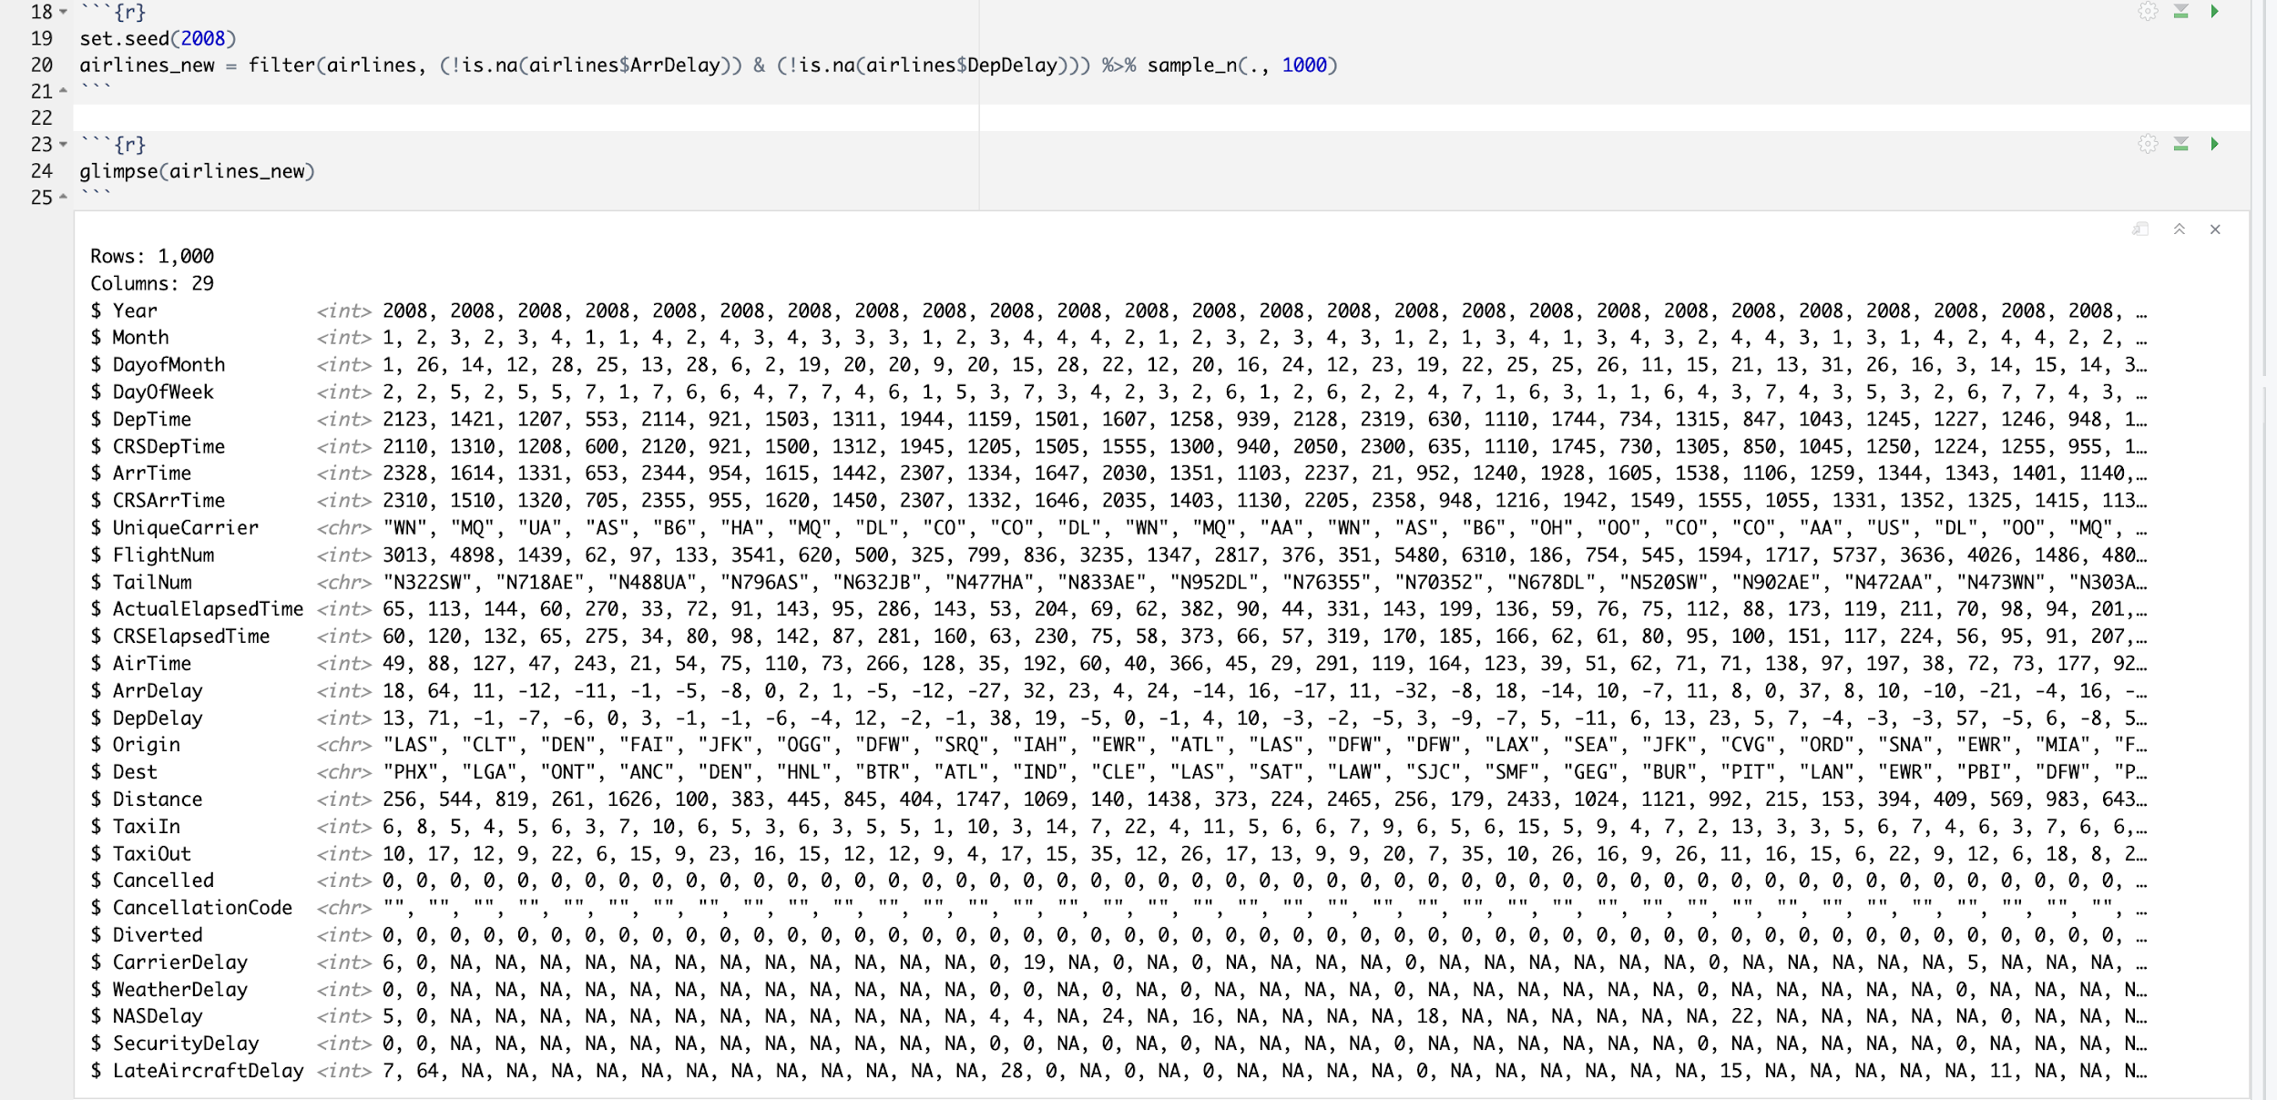
Set Seed Value To Create Same Sample

Slide 5
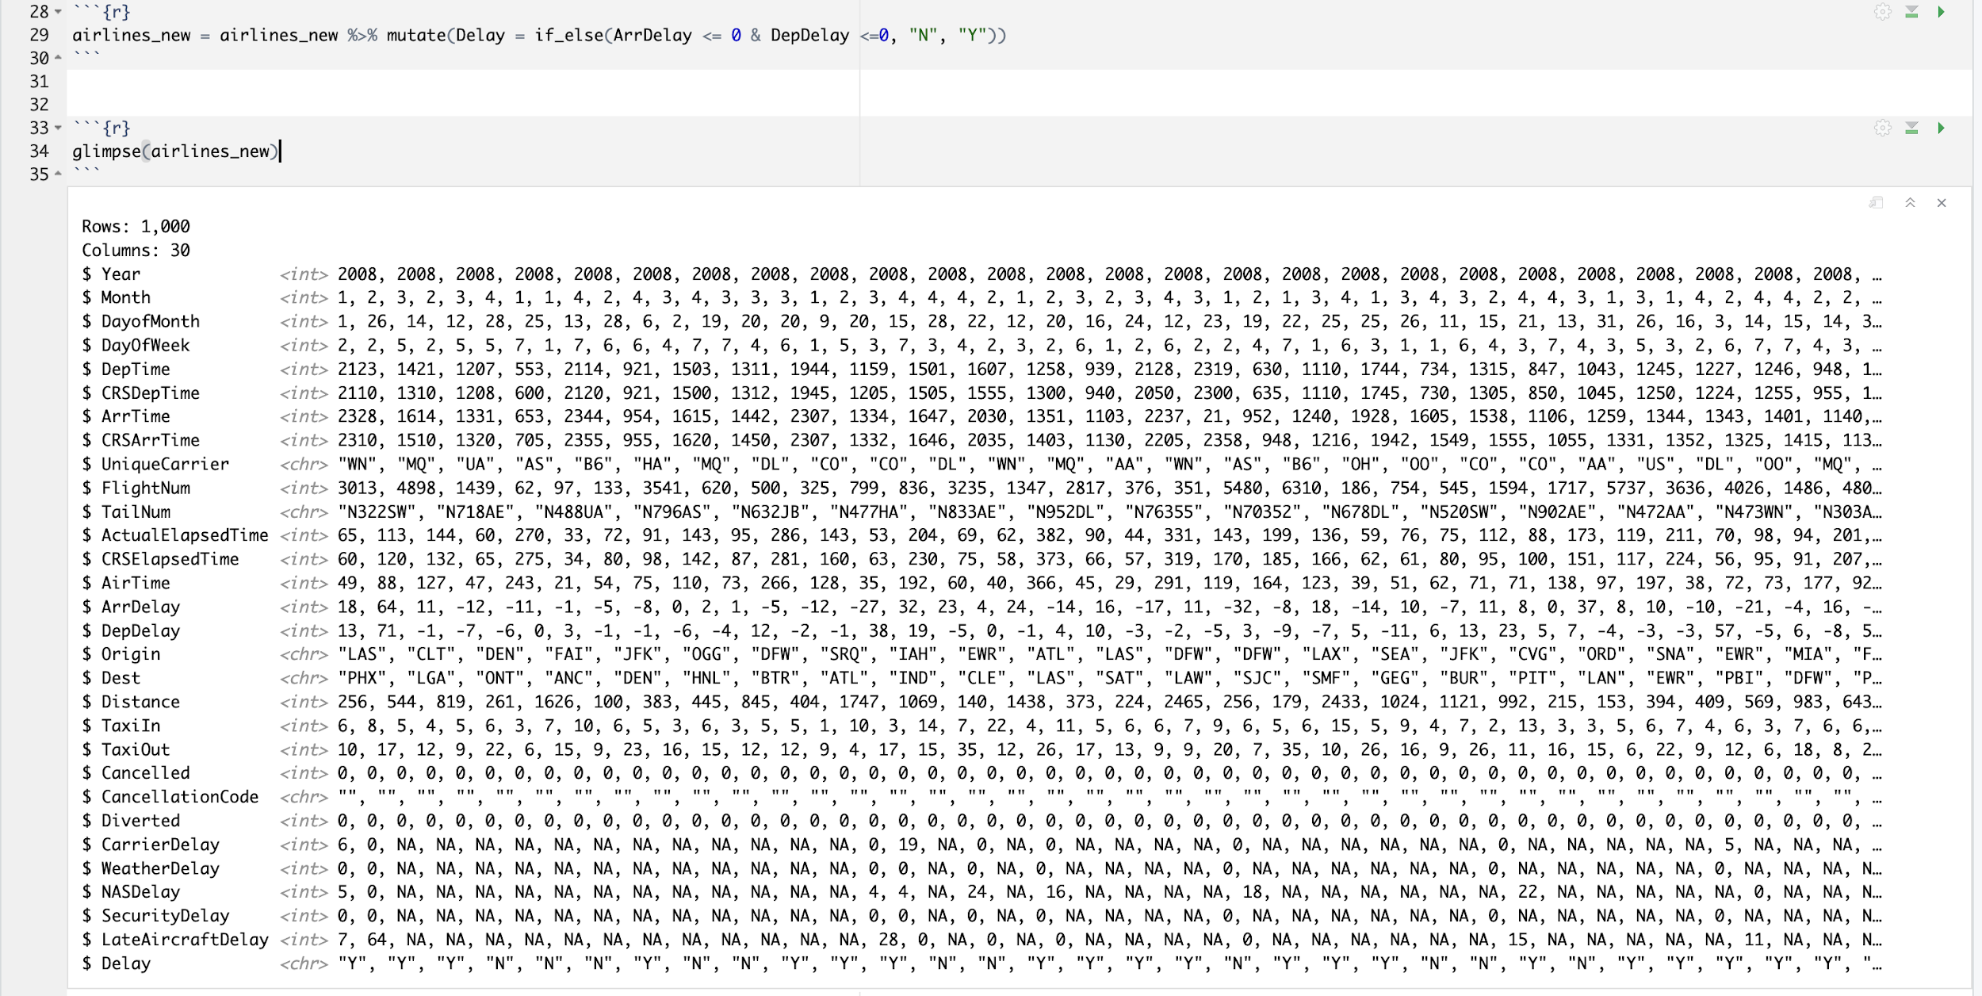
Add New Column Delay

Slide 6
Export Data In CSV File

Slide 7
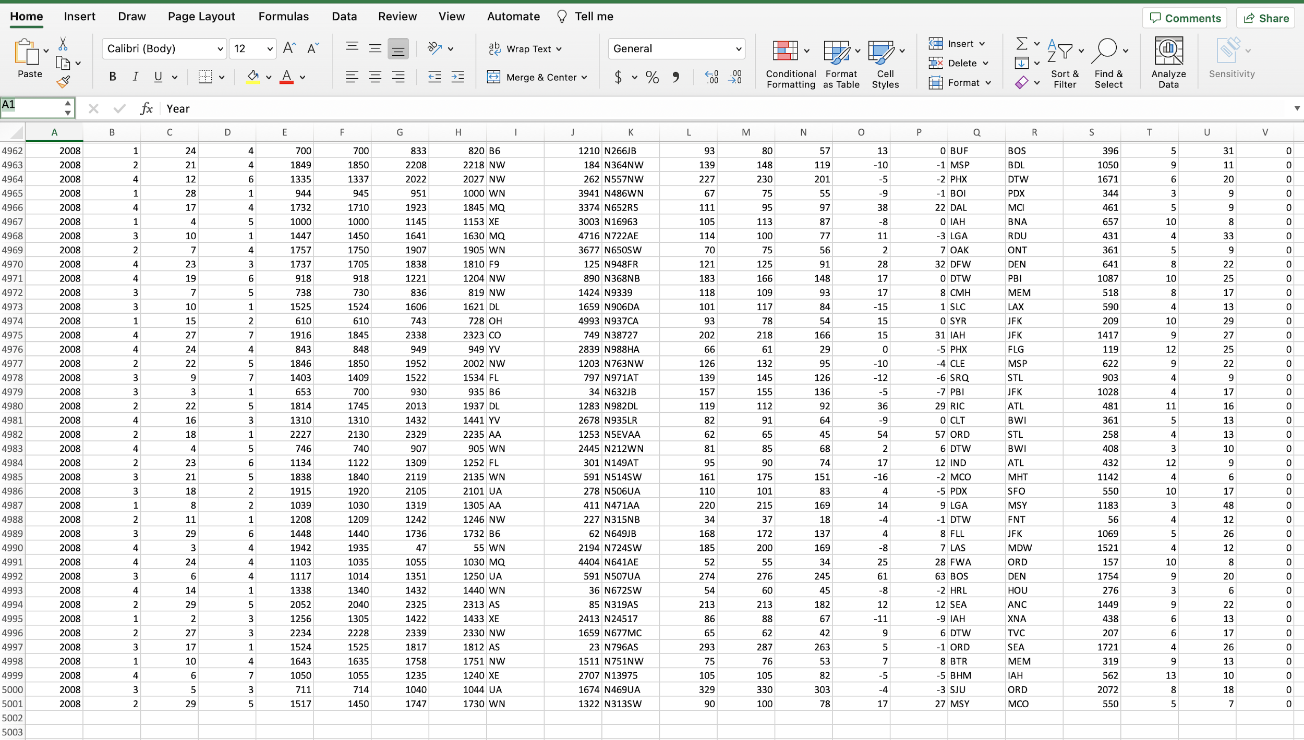
Merge Data

Slide 8
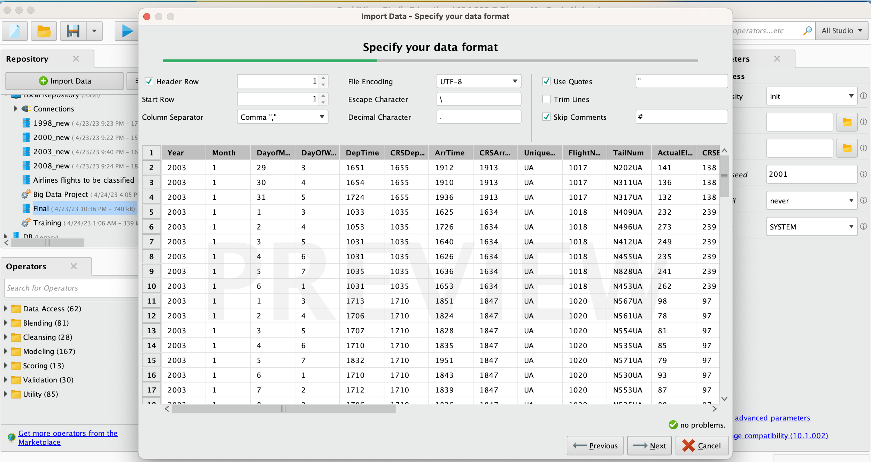
Import Data in RapidMiner

Slide 9
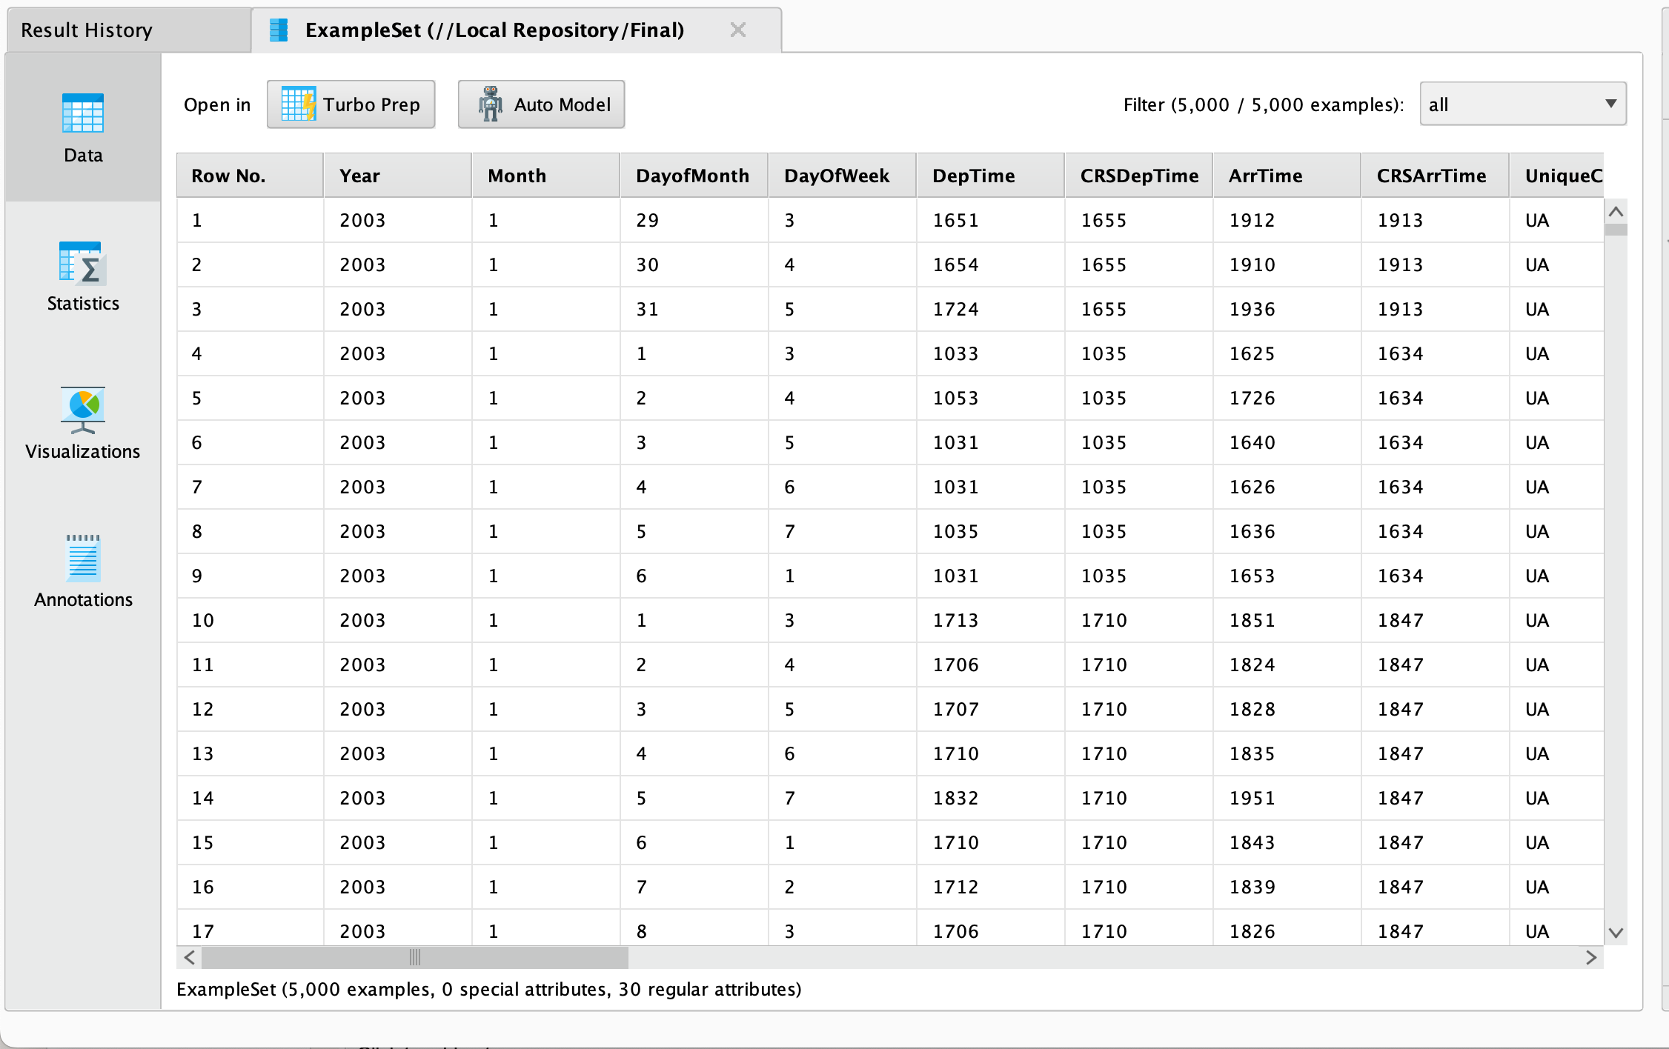
Show Data

Slide 10
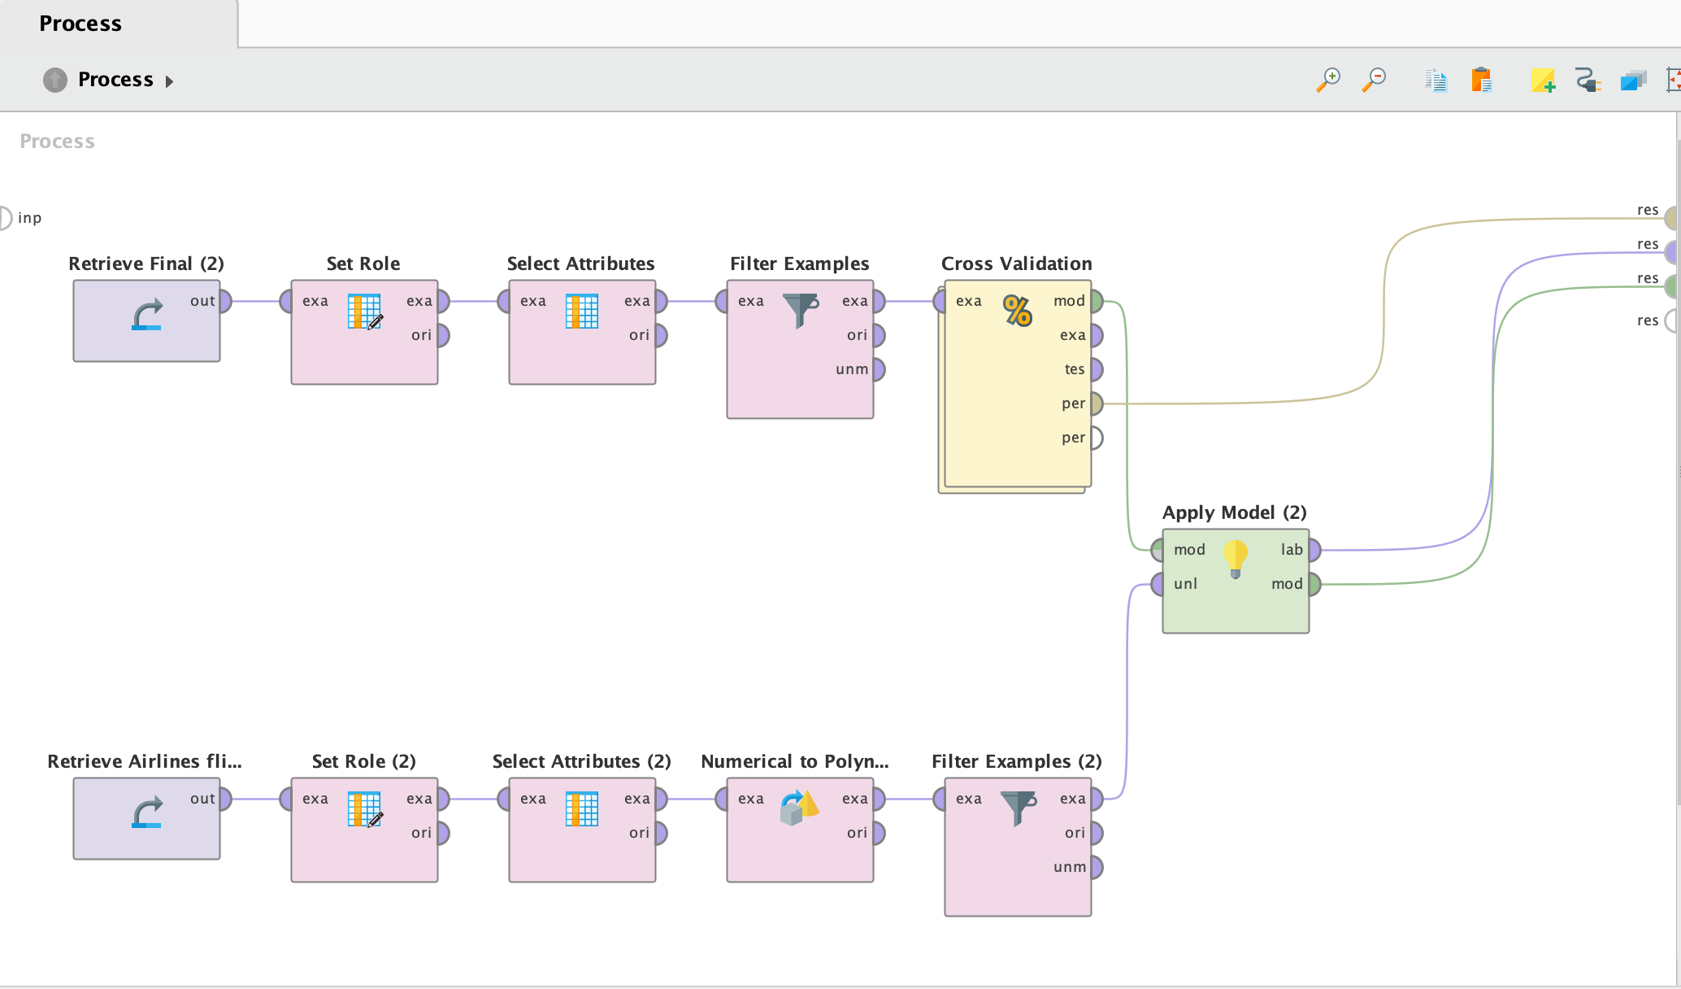
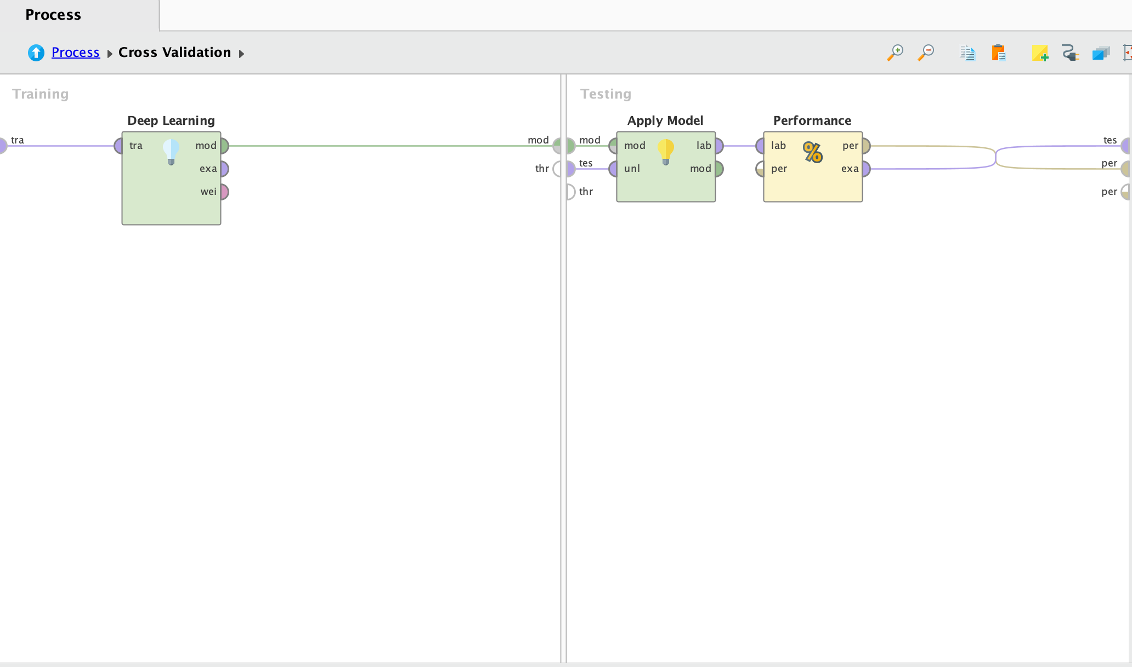
Prepare Model: Deep Learning

Slide 11
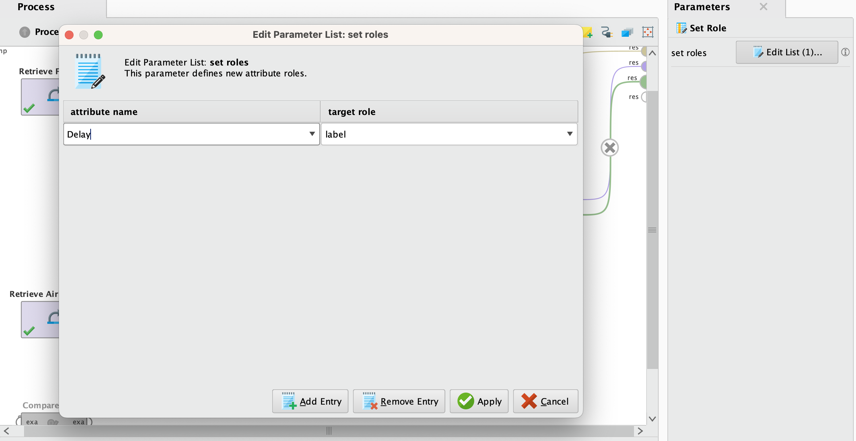
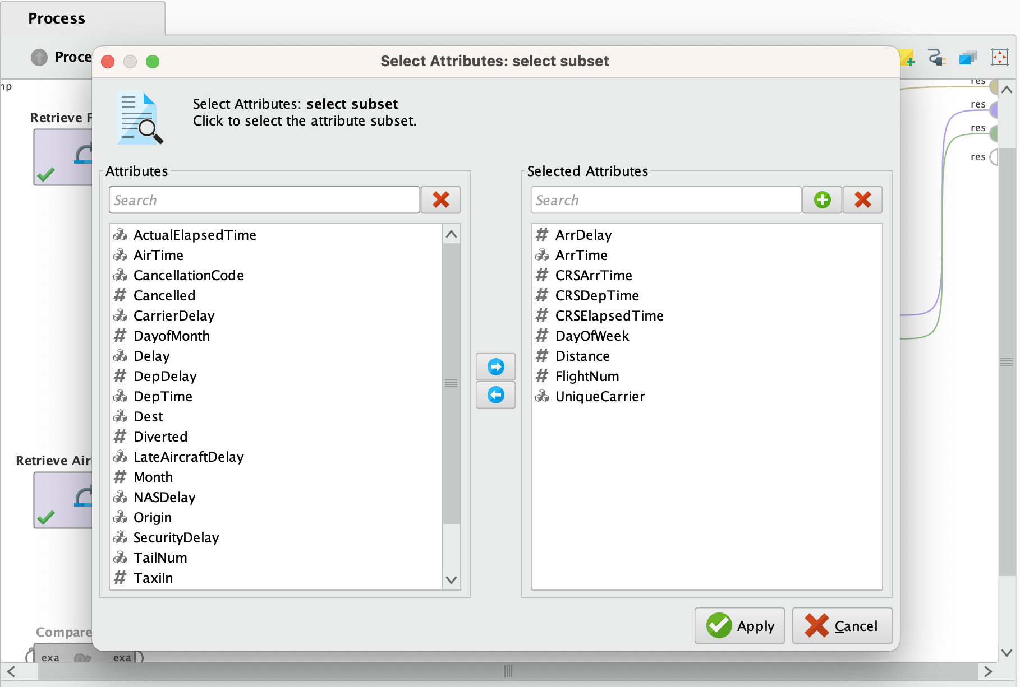
Pre-process Data

Slide 12
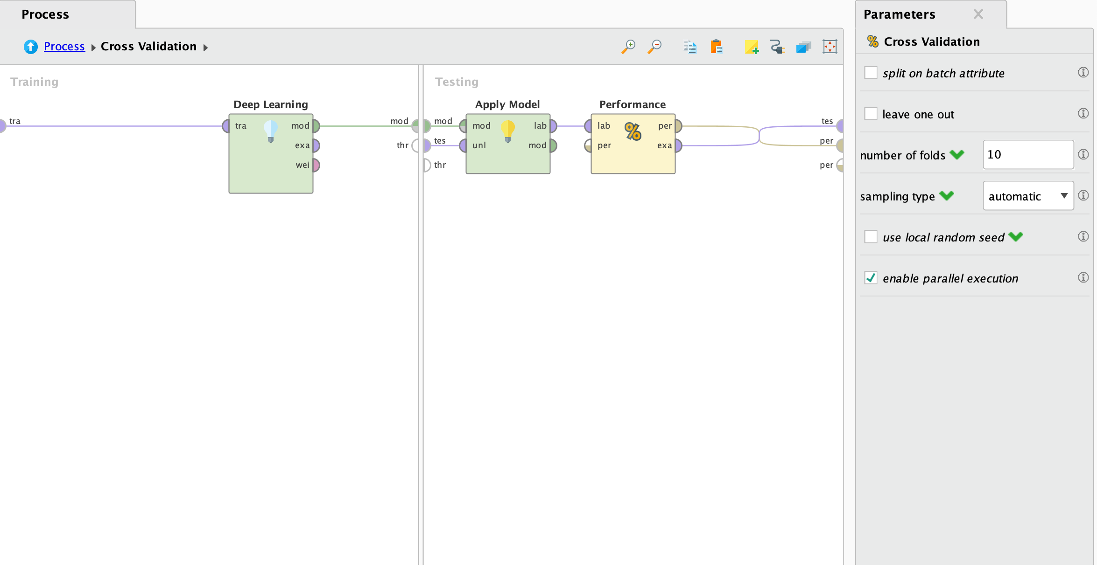
Cross Validation

Slide 13
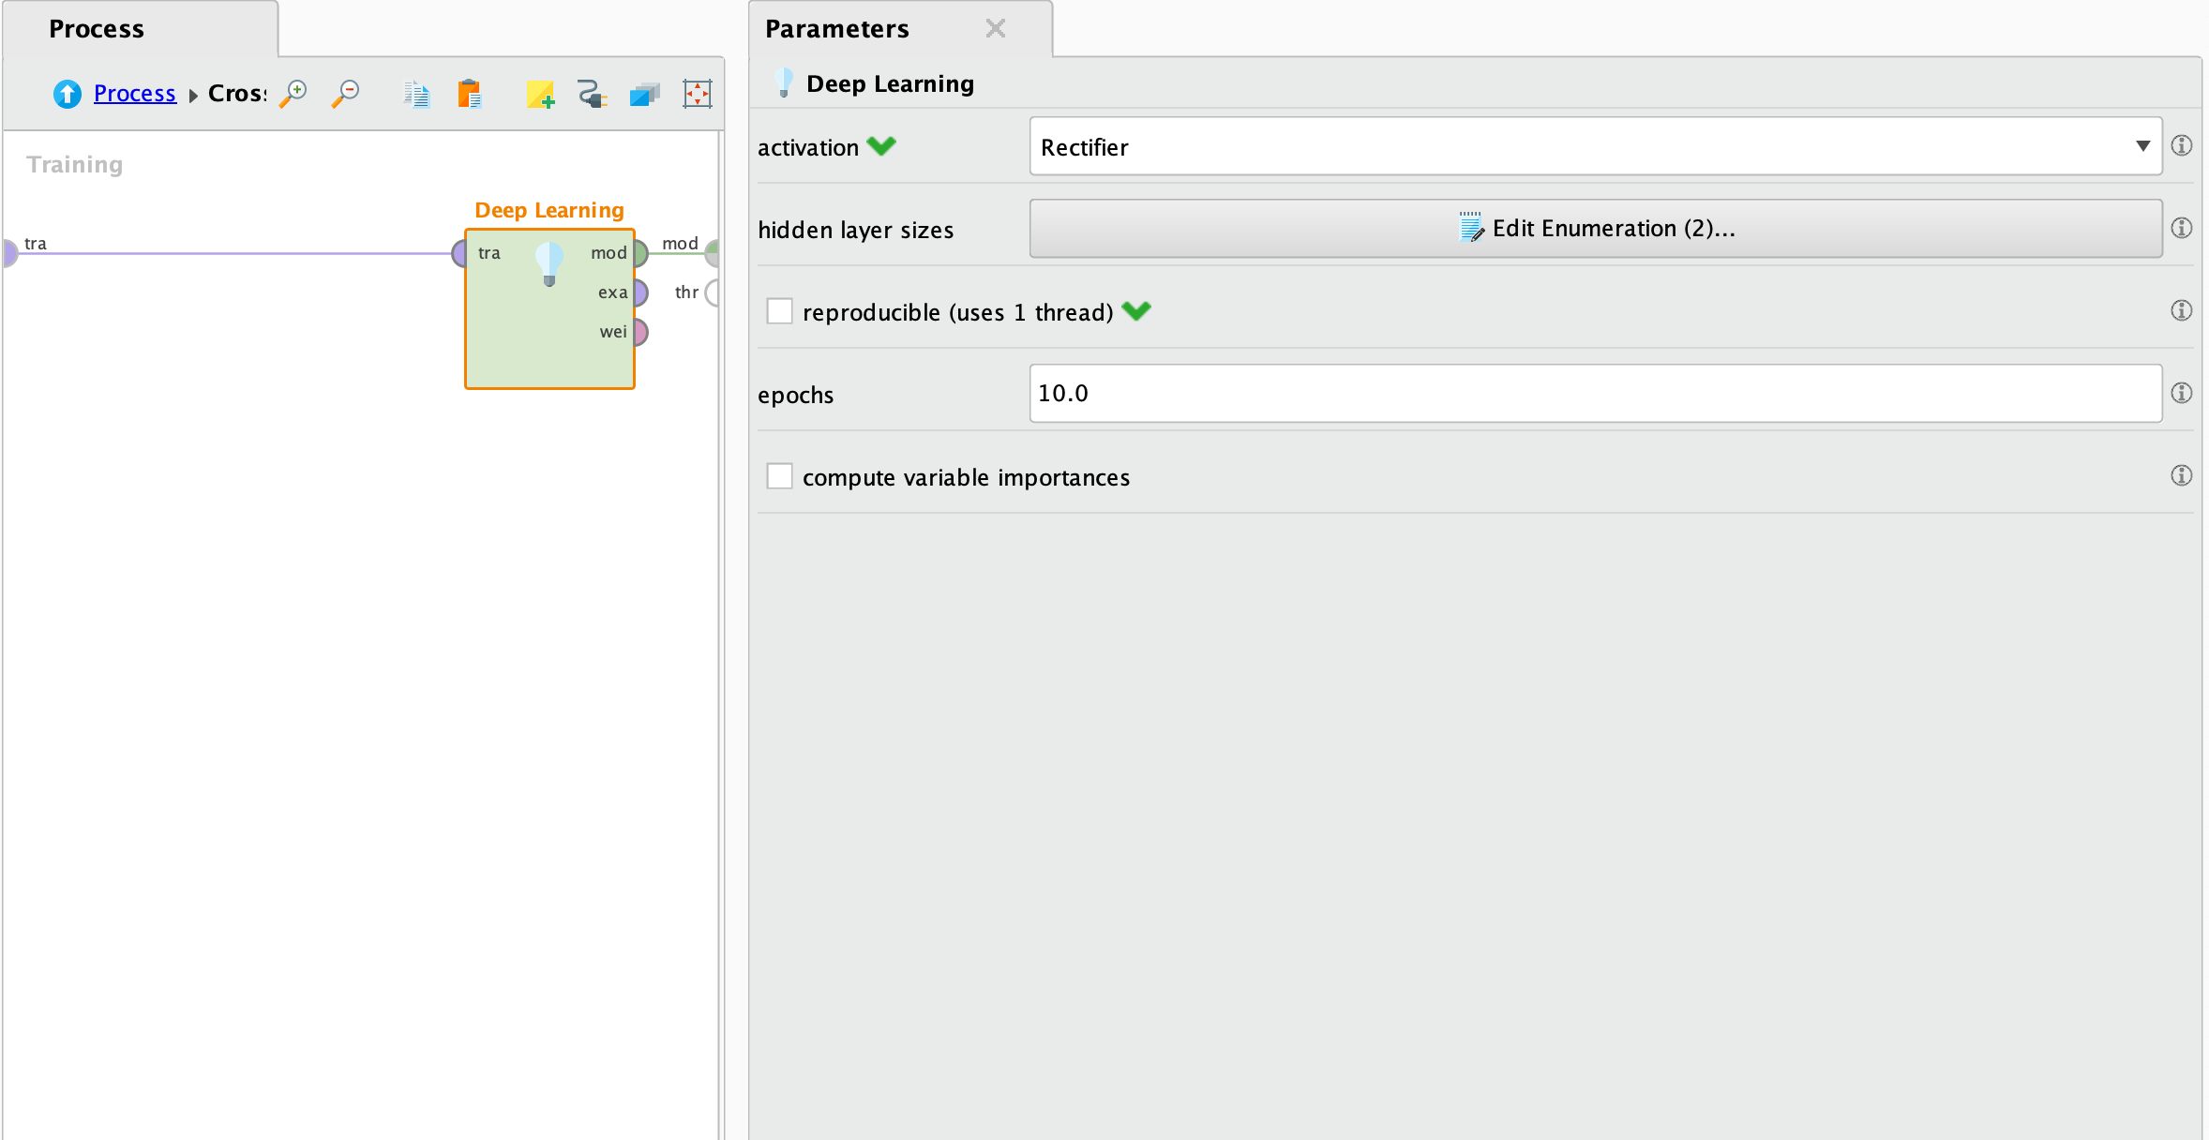
Model: Deep Learning

Slide 14
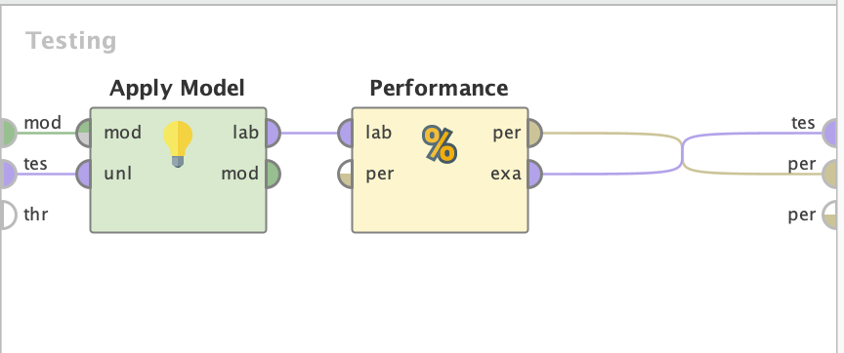
Apply Model To Test Data

Slide 15
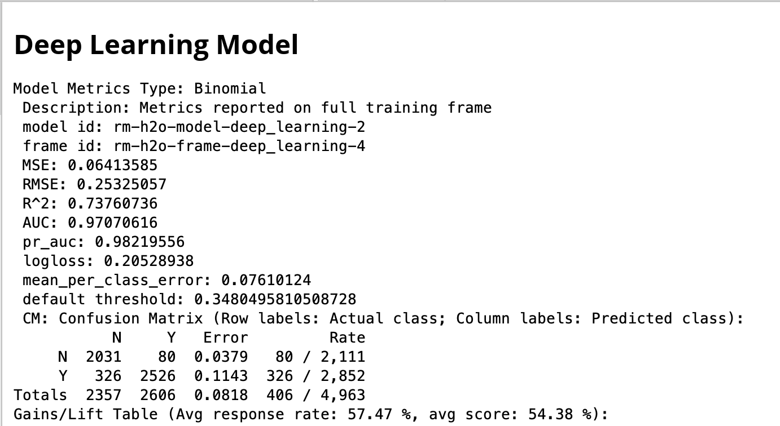
Result

Slide 16
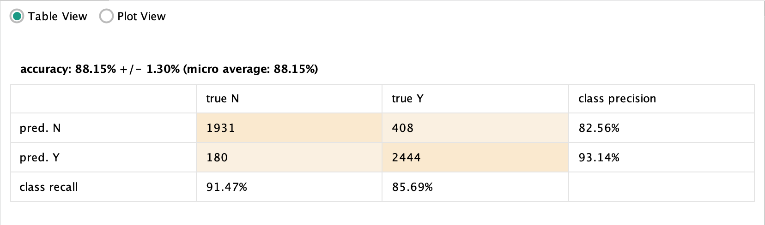
Result: Accuracy

Slide 17
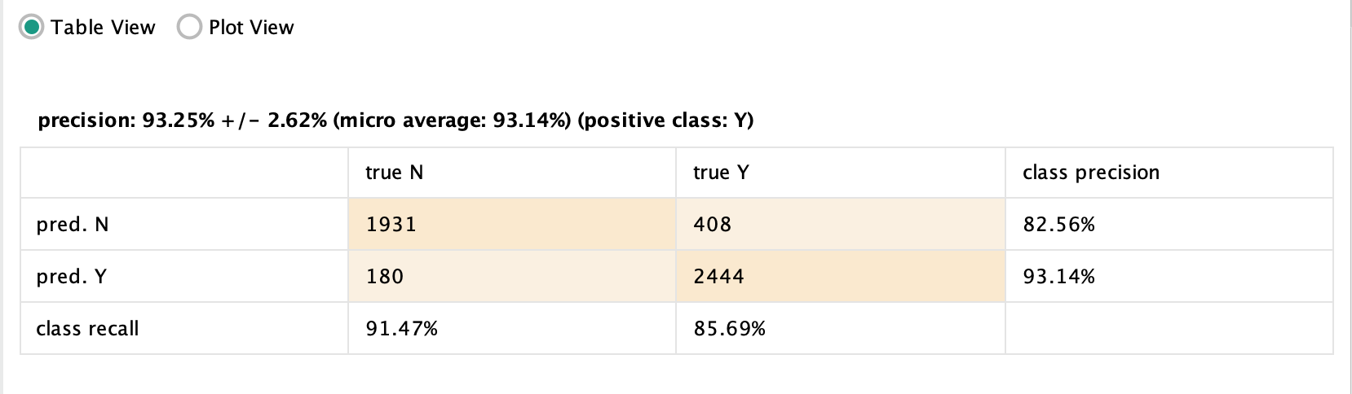
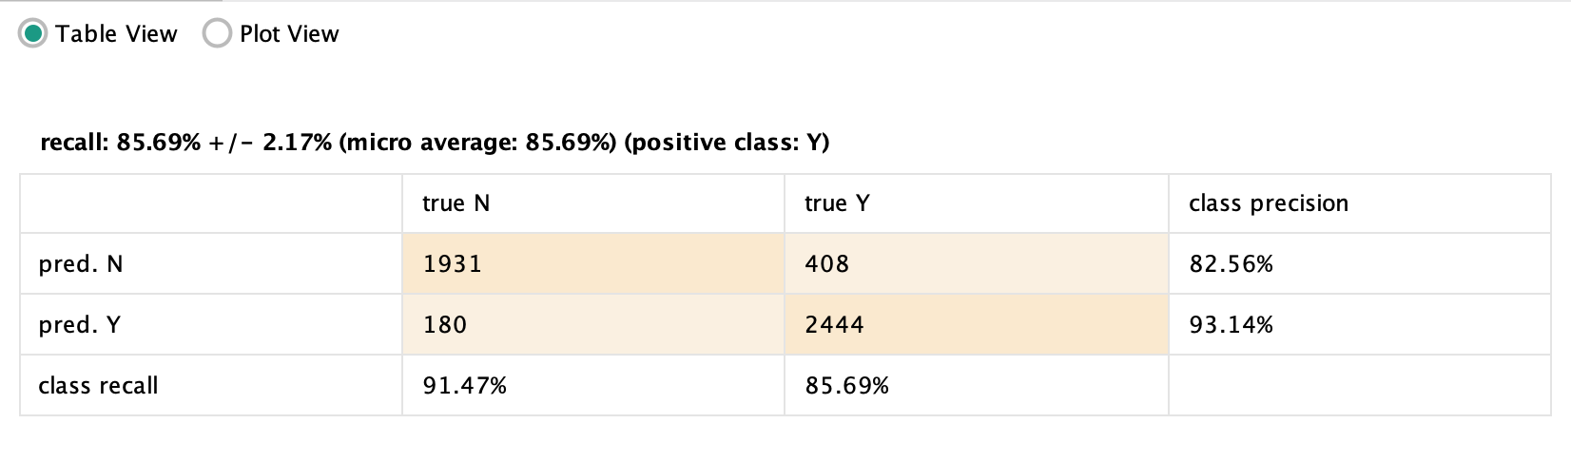
Result: Precision And Recall

Slide 18
Model: Gradient Boosted Trees
Presented By:
Mohammed Sahil Fnu

Slide 19
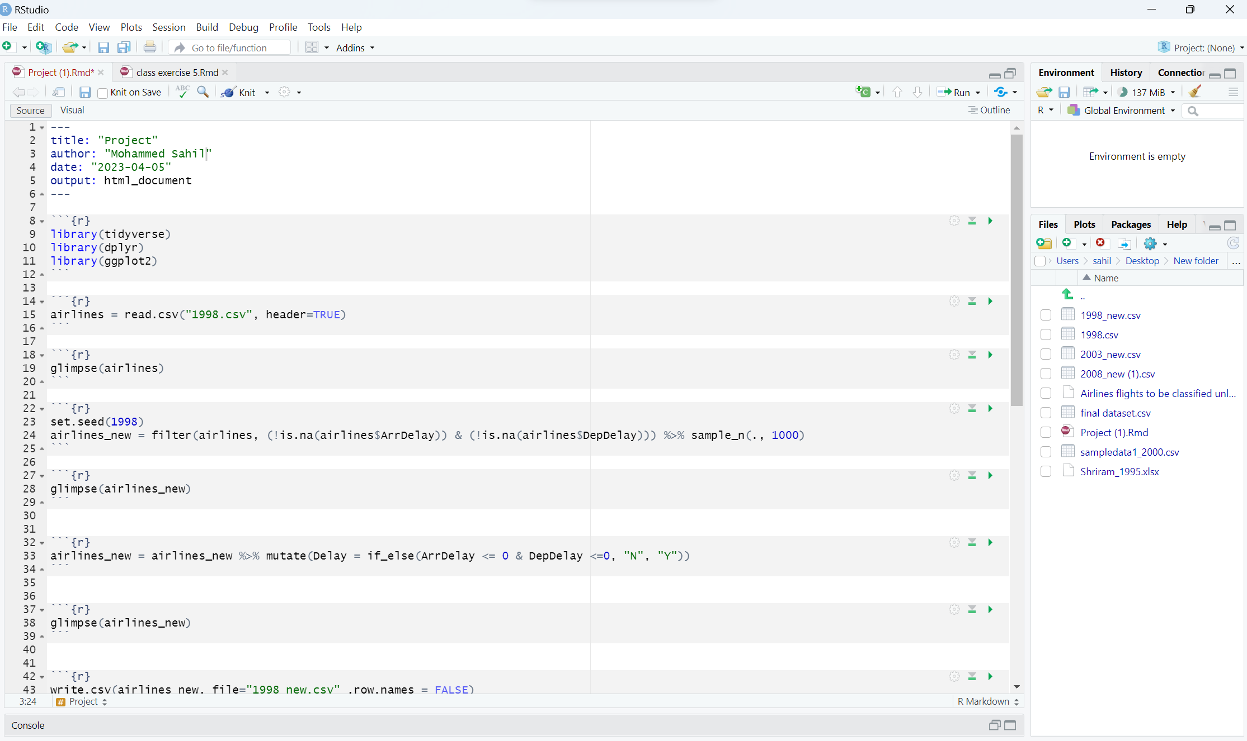
Creating Random Sample

Slide 20
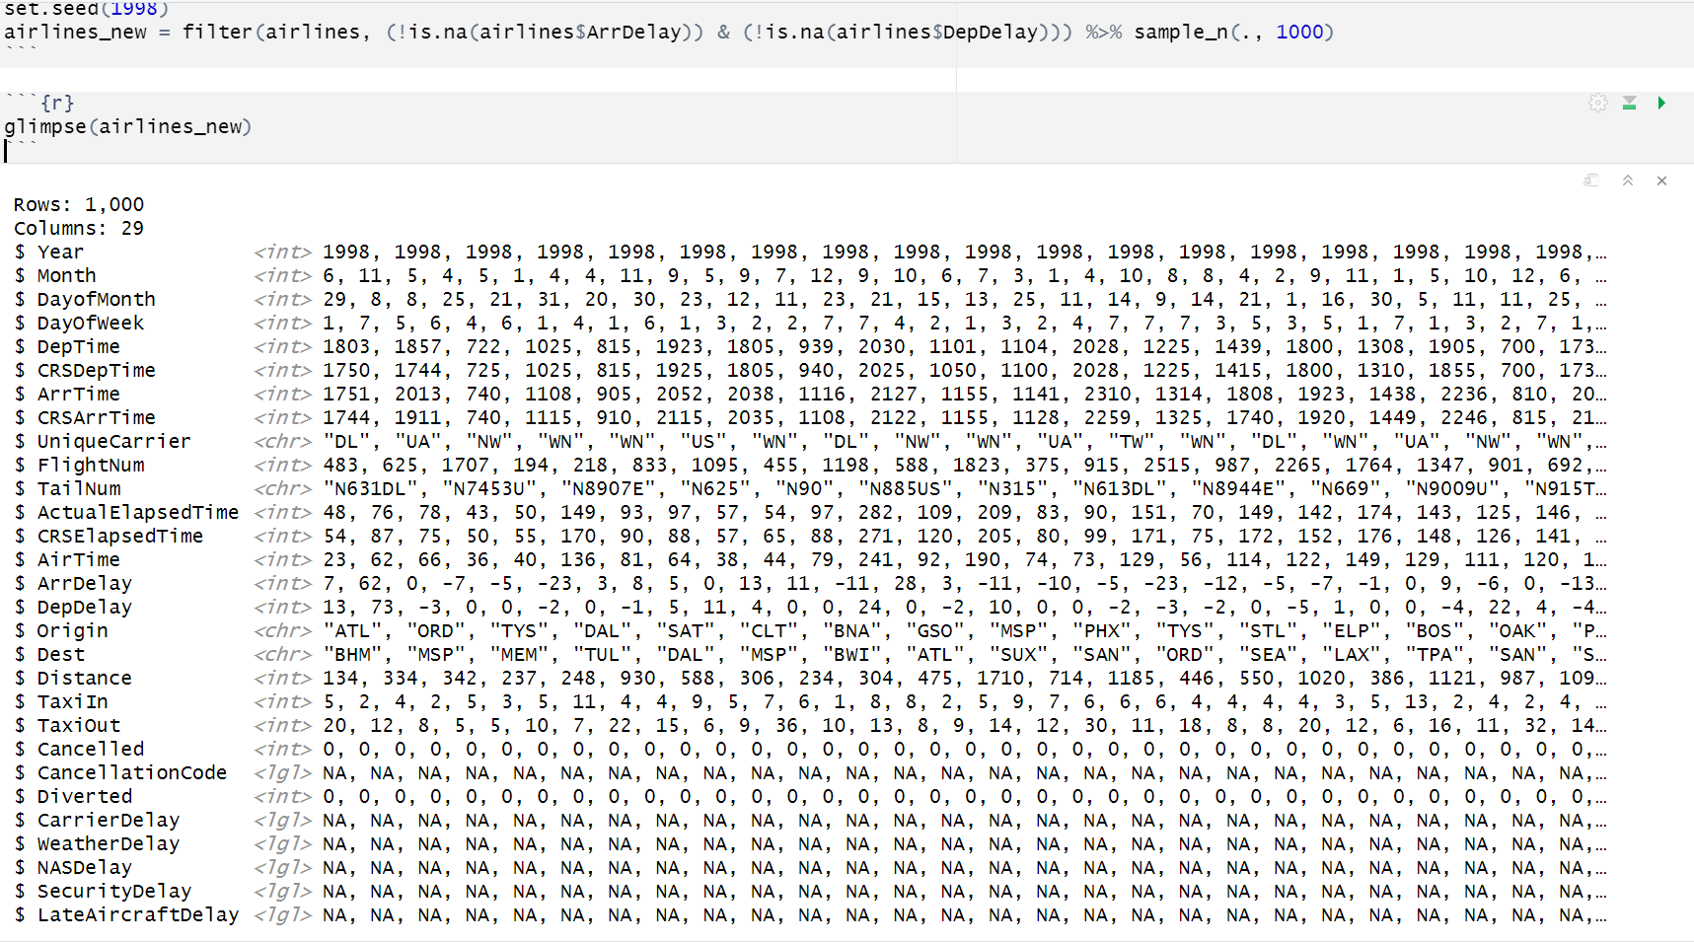
SET SEED VALUE TO CREATE SAME SAMPLE

Slide 21
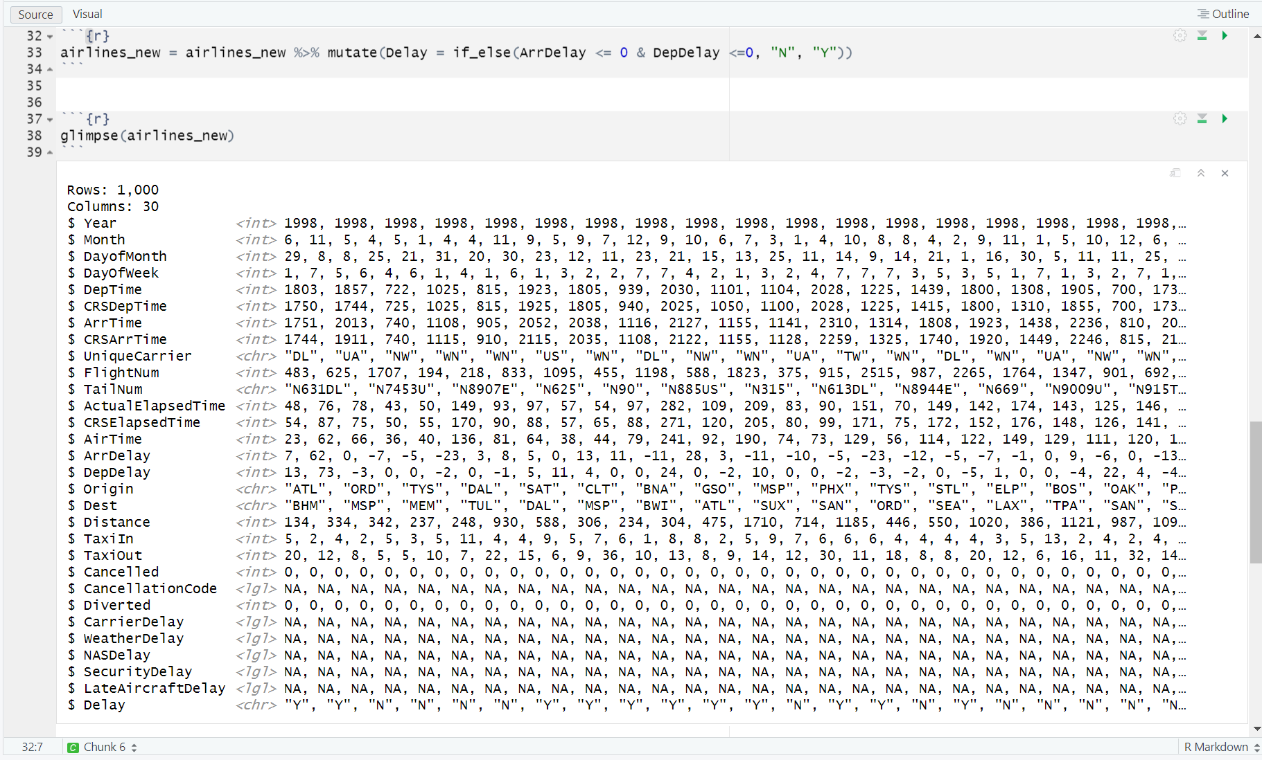
Add new Column Delay

Slide 22
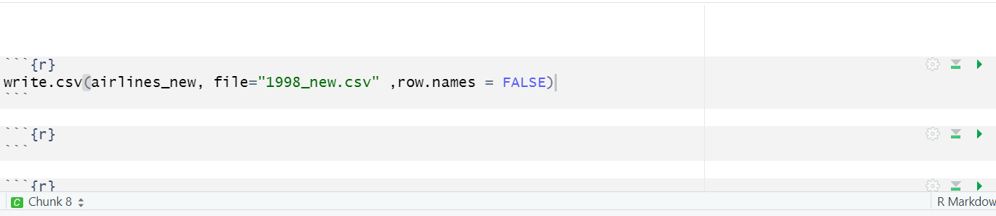
Export Data in CSV File

Slide 23
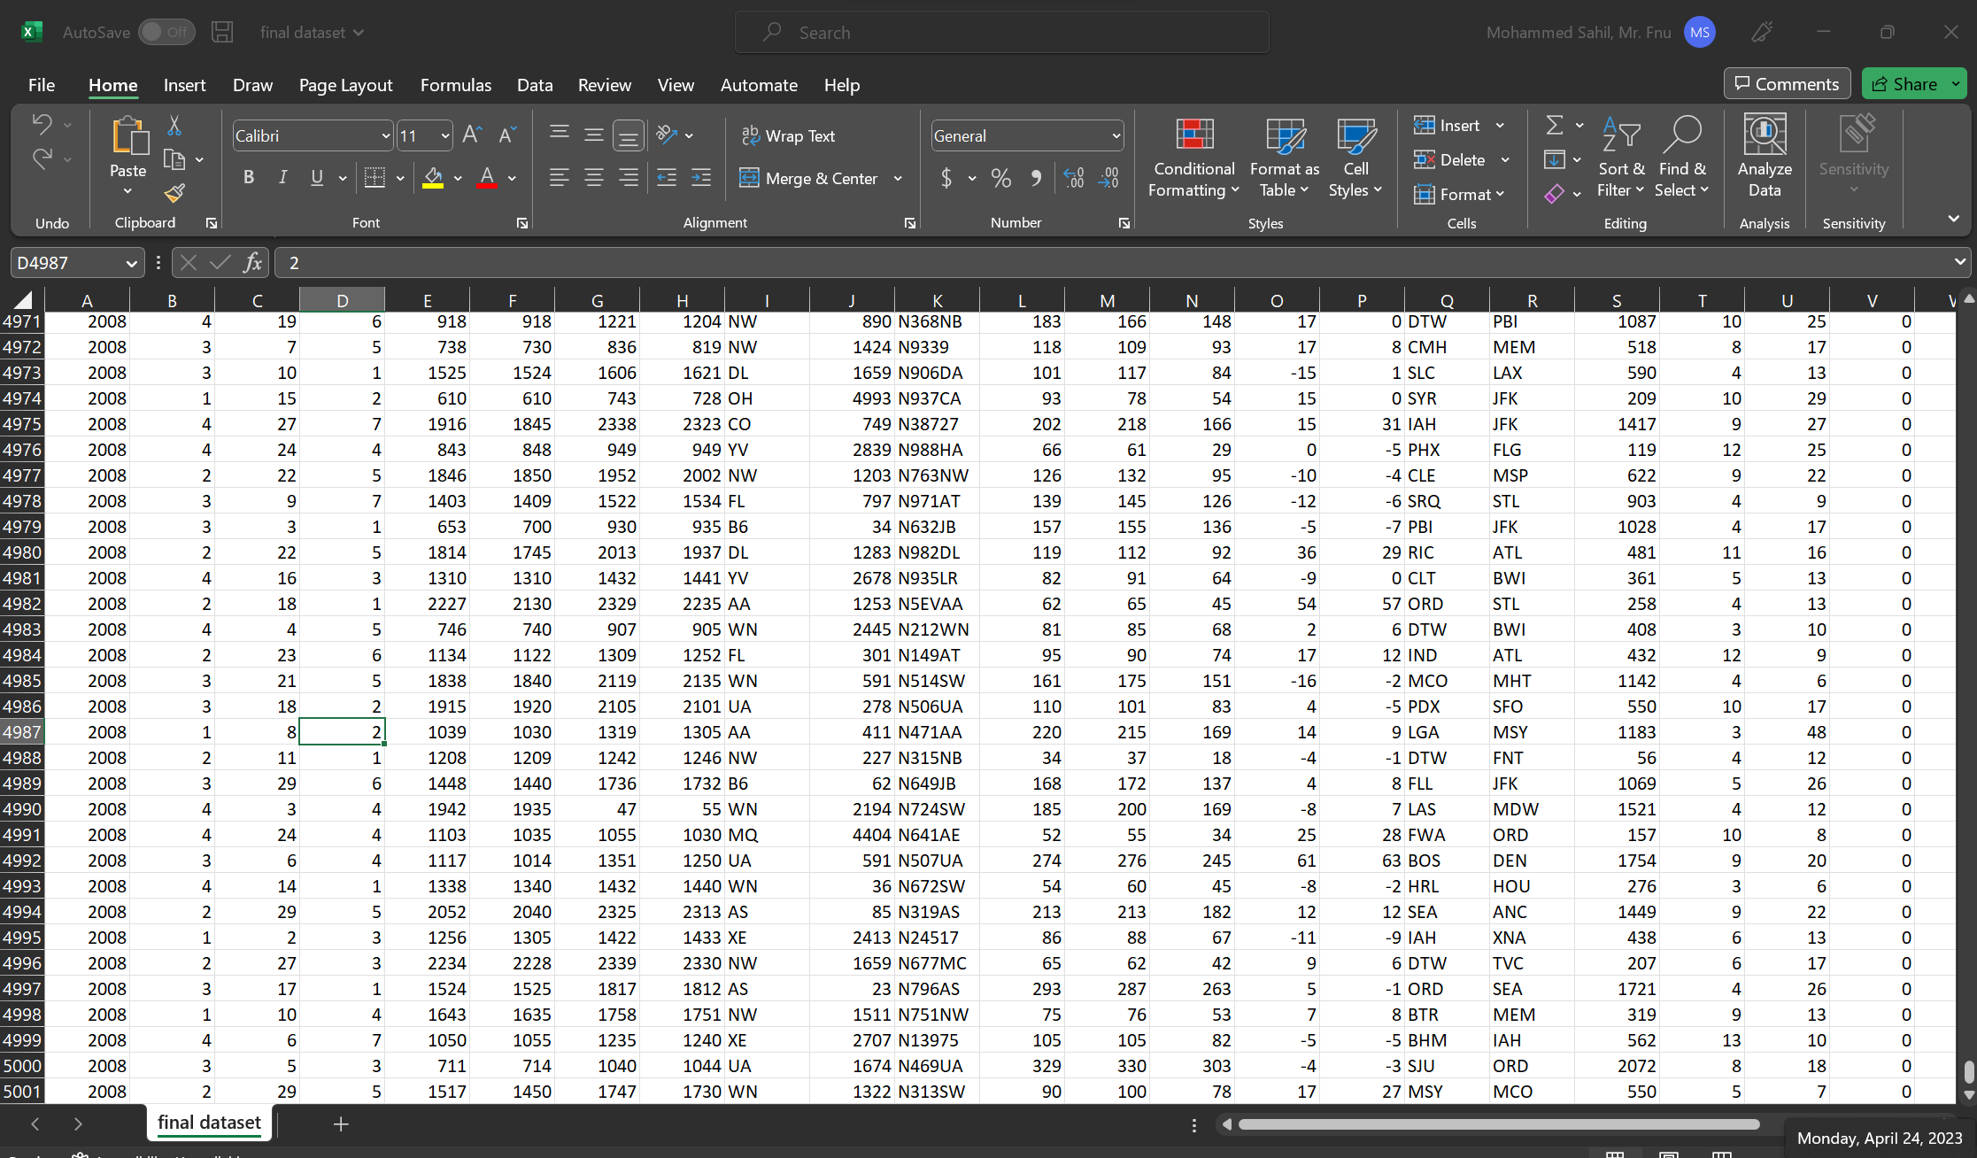
Merge Data

Slide 24
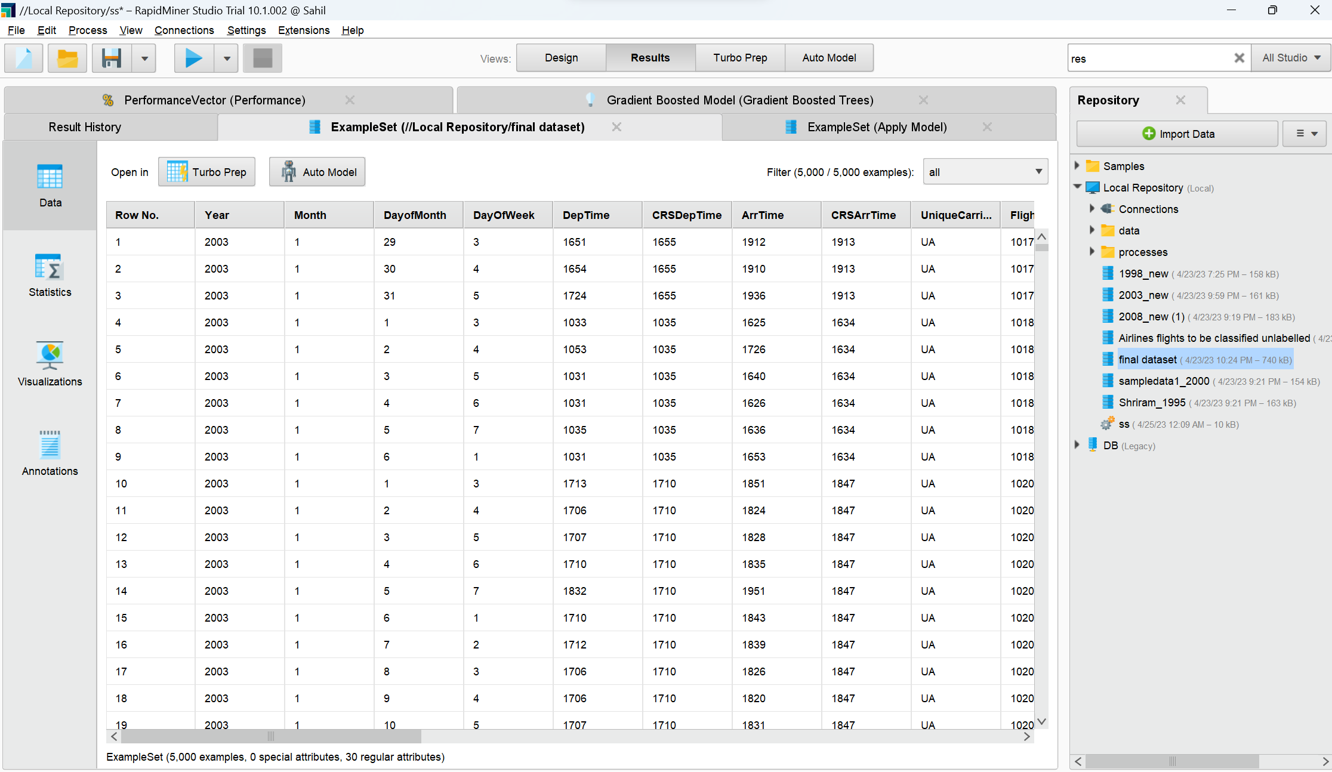
Import Data in RapidMiner

Slide 25
Show Data

Slide 26
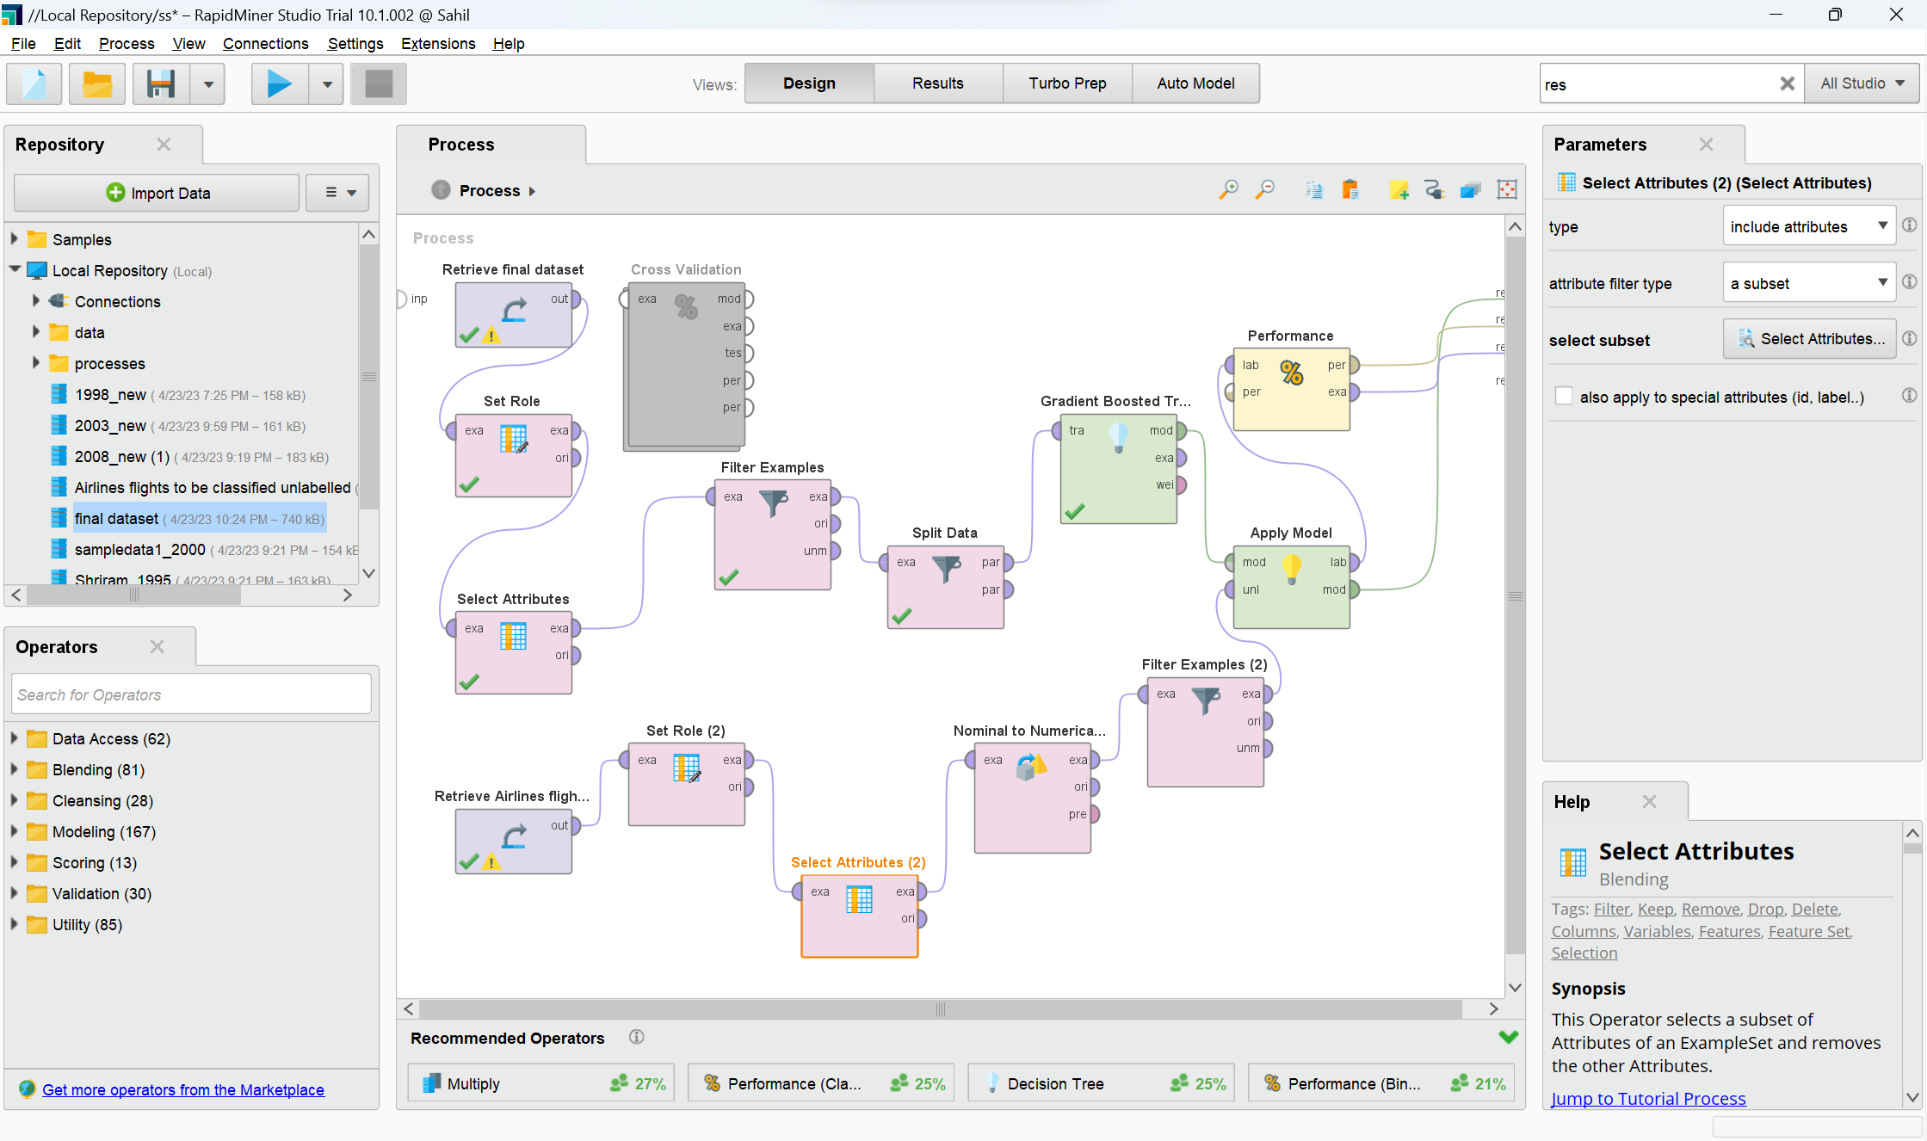
Prepare Model - Gradient Boosted Tree

Slide 27
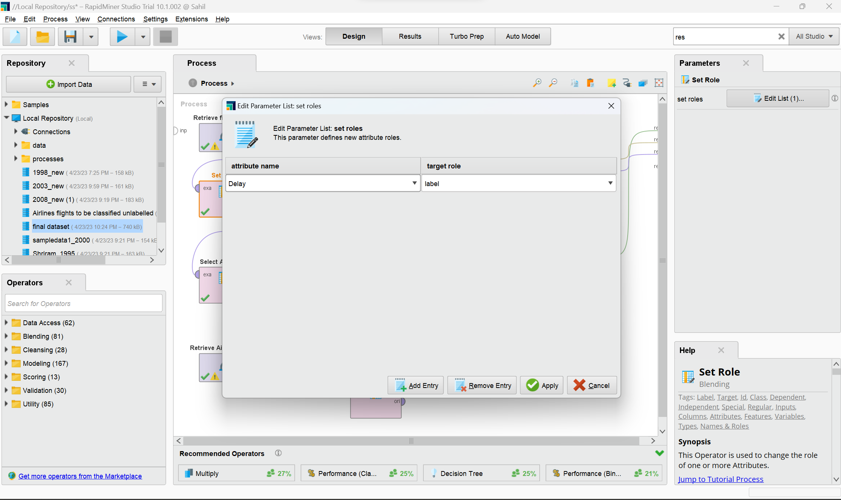
Pre-Process Data

Slide 28
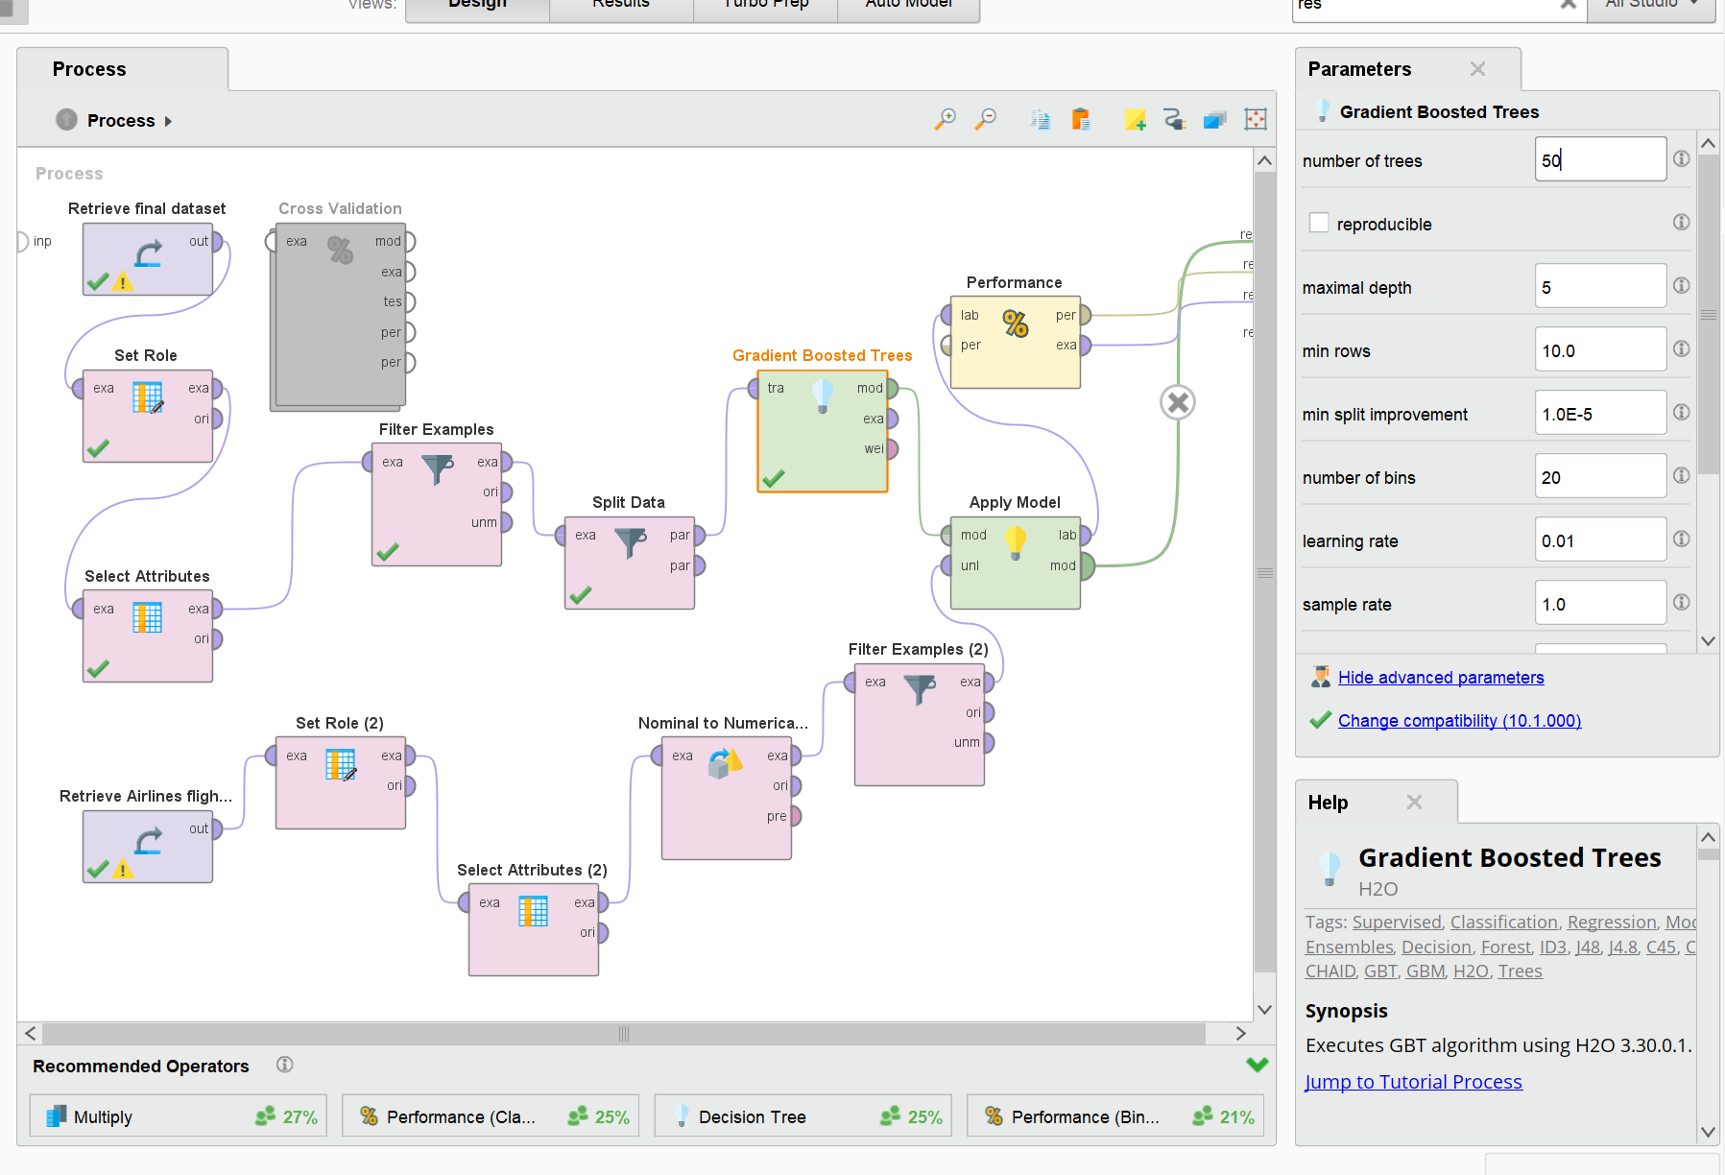
GRADIENT BOOSTED TREES

Slide 29
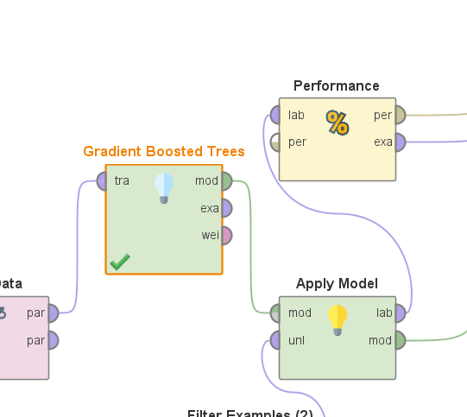
Apply Model to Test Data

Slide 30
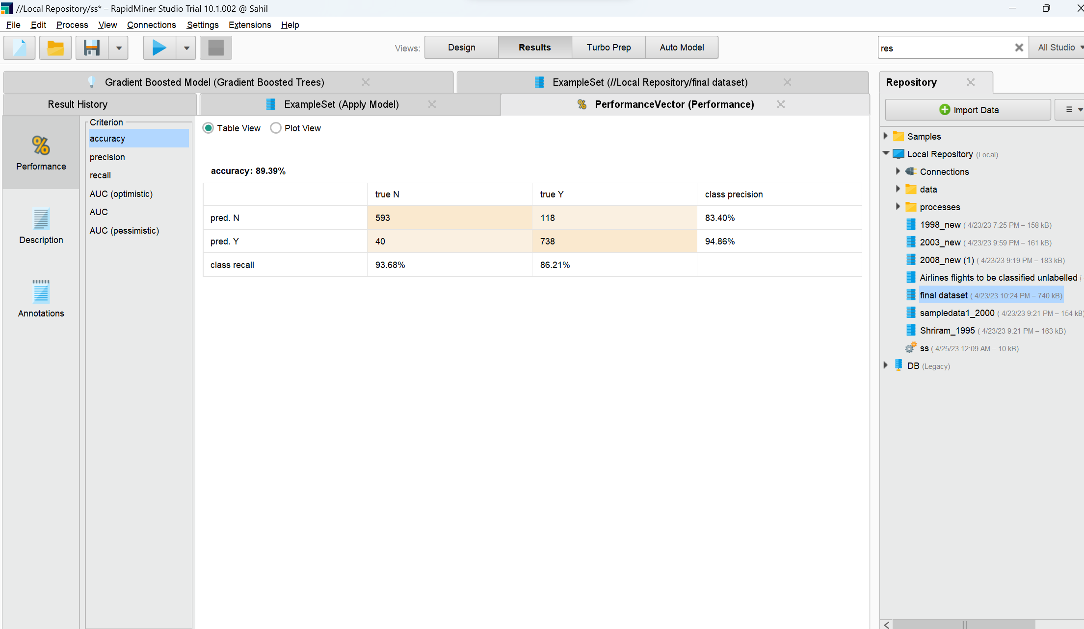
Result: Accuracy

Slide 31
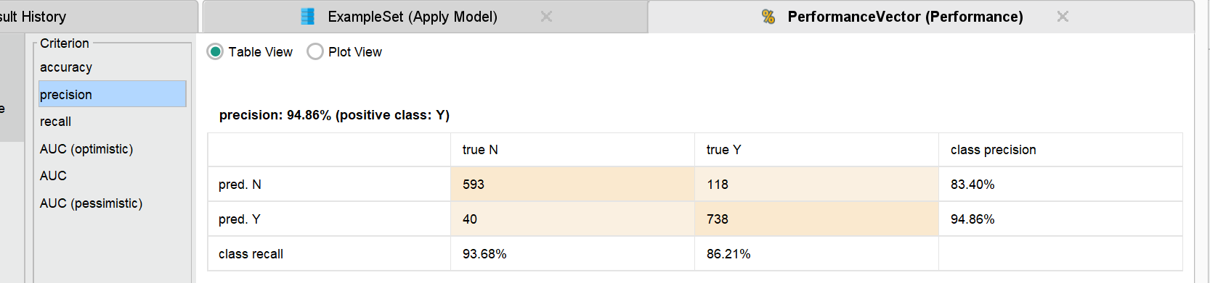
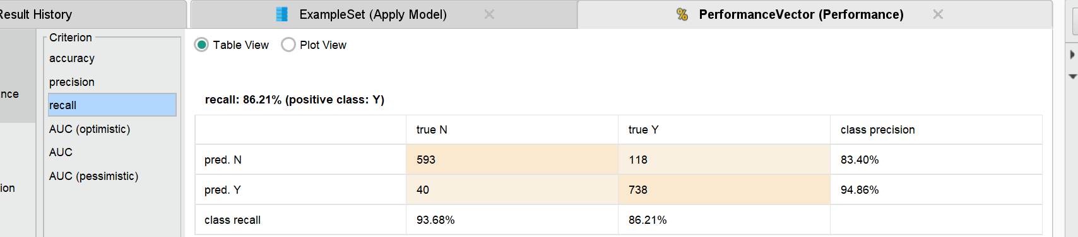
Result: Precision & Recall

Slide 32
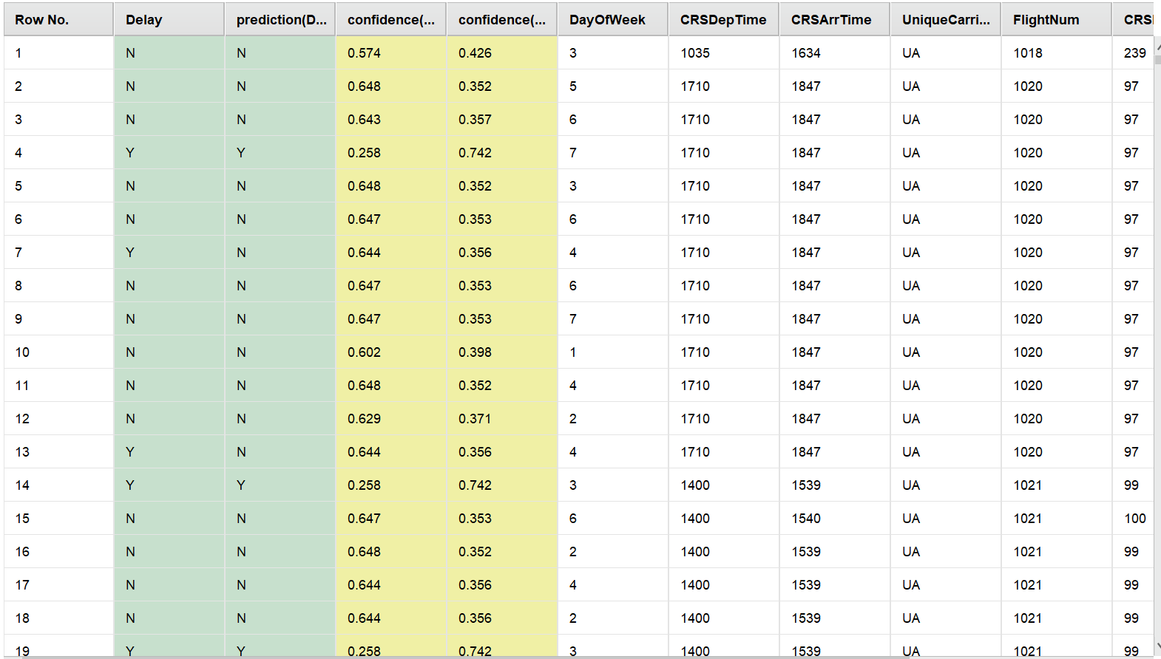
Prediction

Slide 33
Model: Logistic Regression
Presented By:
Mahesh Kate

Slide 34
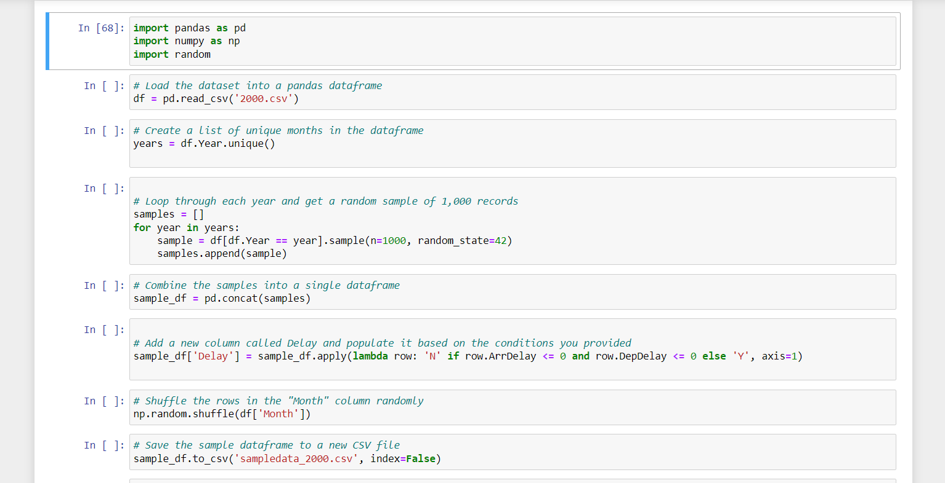
Random sample of 1,000 records from year 2000. Add and Populate the Delay column

Slide 35
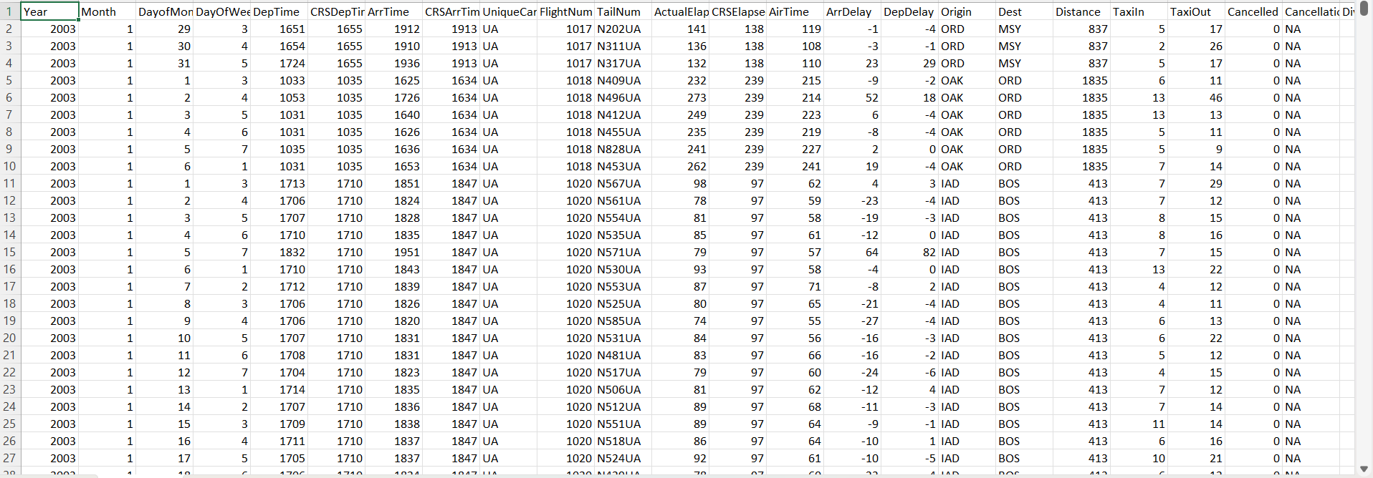
Combined data

Slide 36
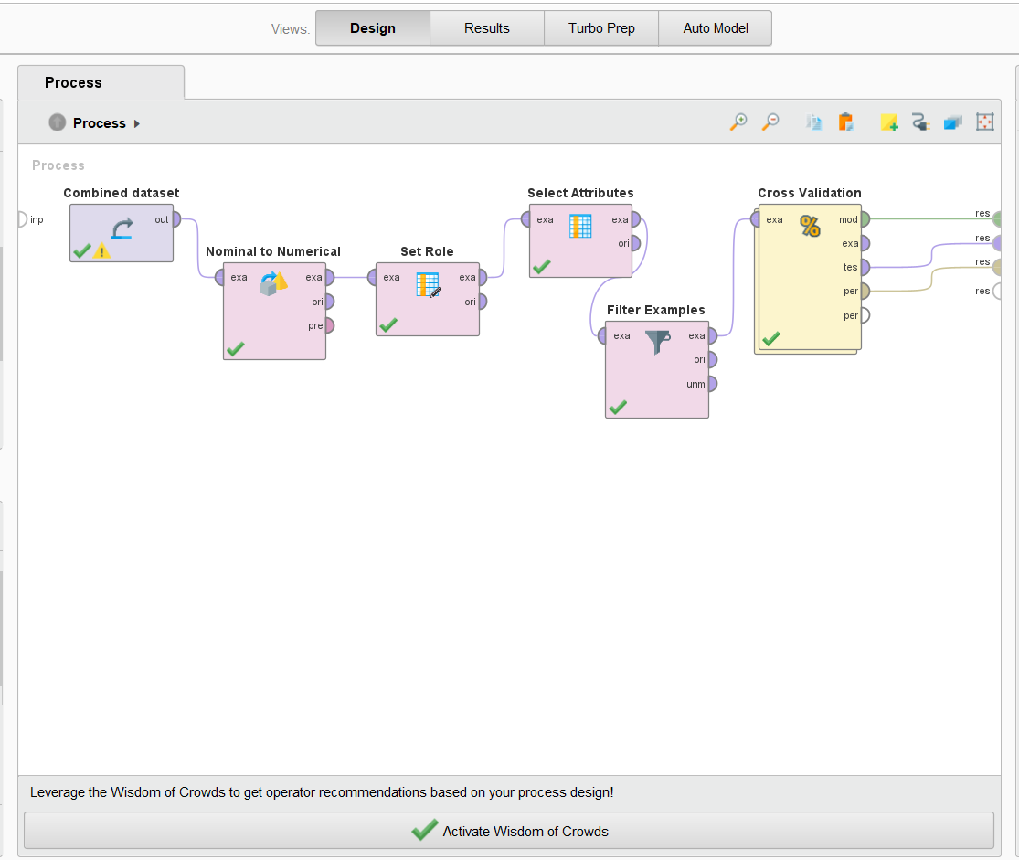
Prepare Model : Logistic Regression

Slide 37
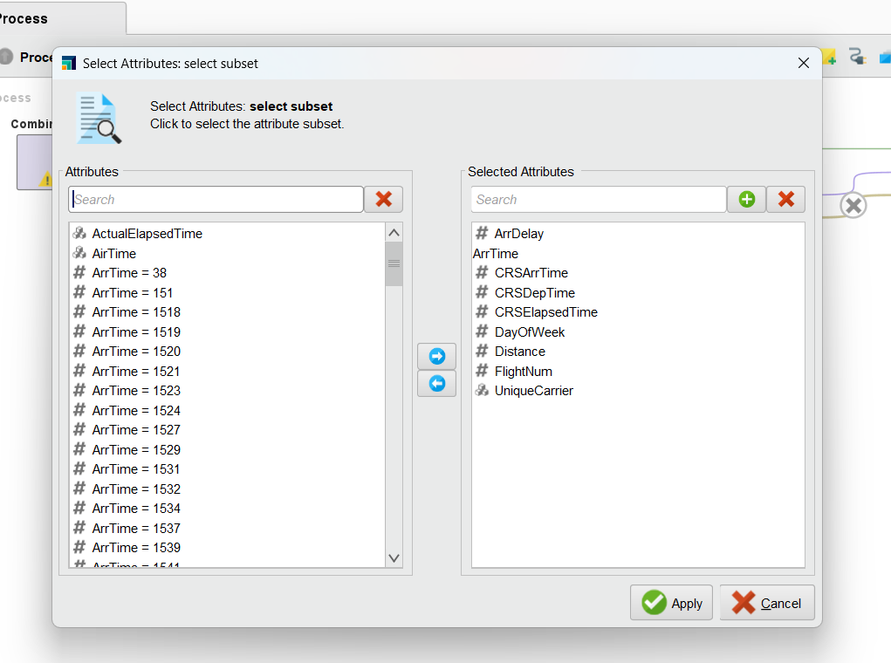
Case Attributes

Slide 38
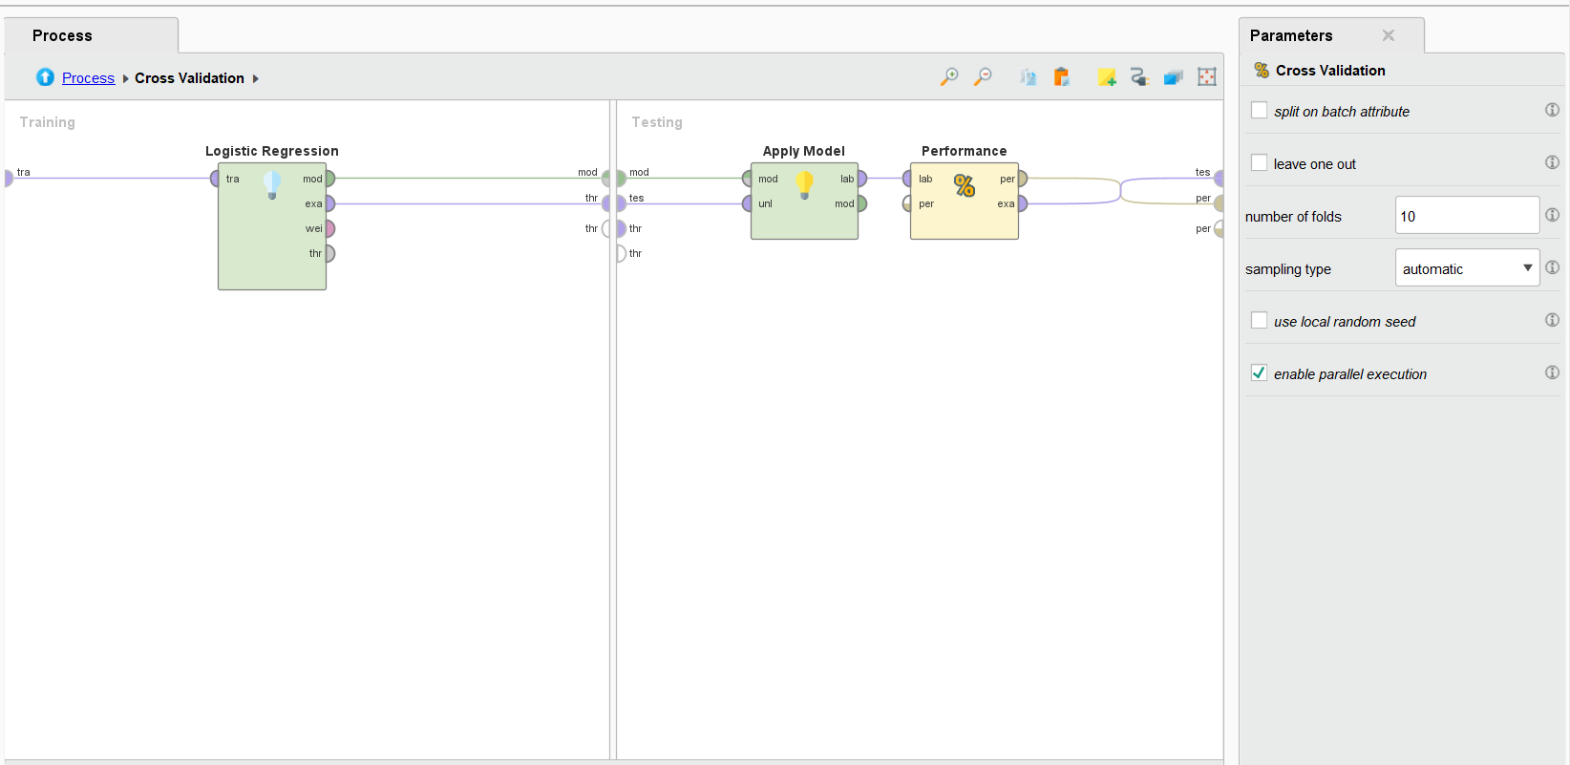
Cross Validation

Slide 39
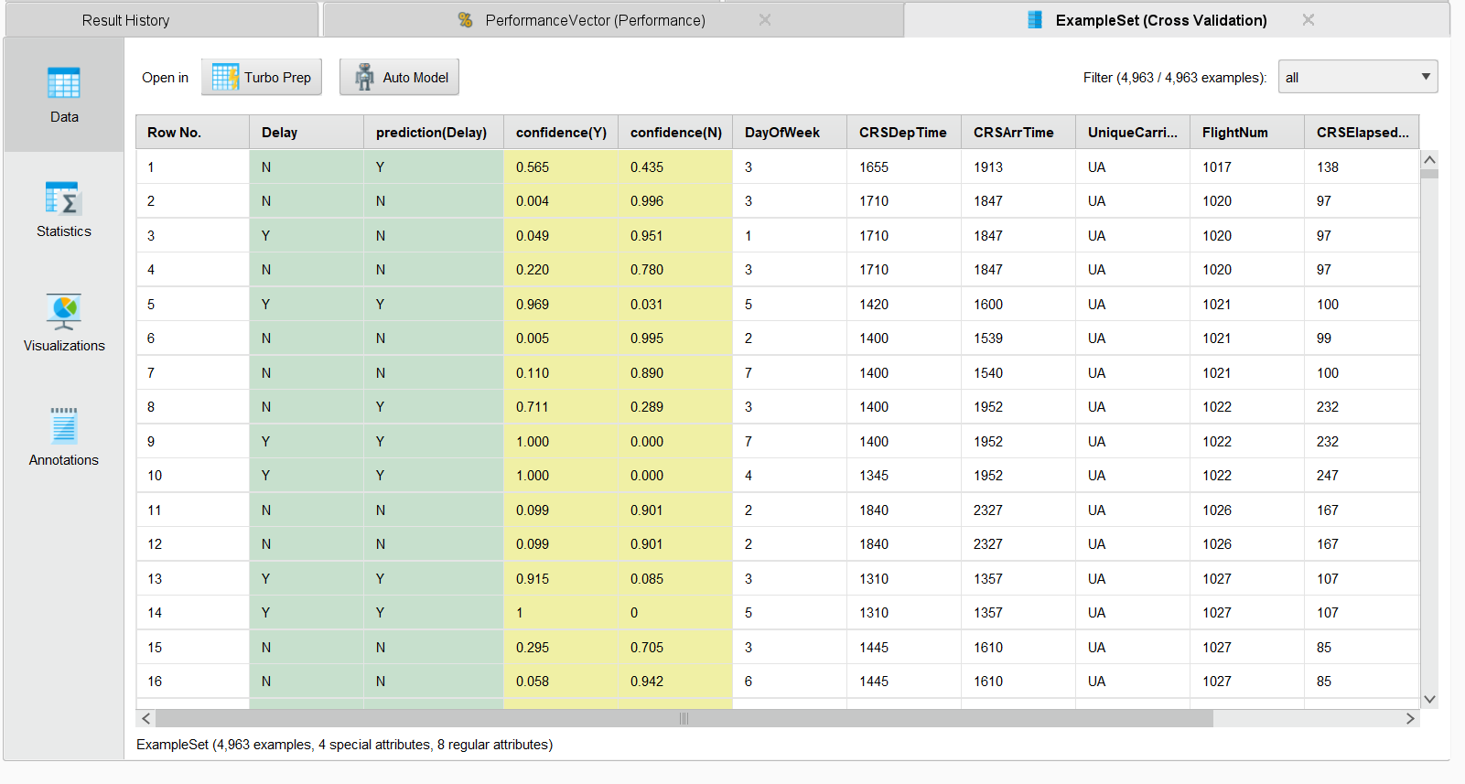
Prediction

Slide 40
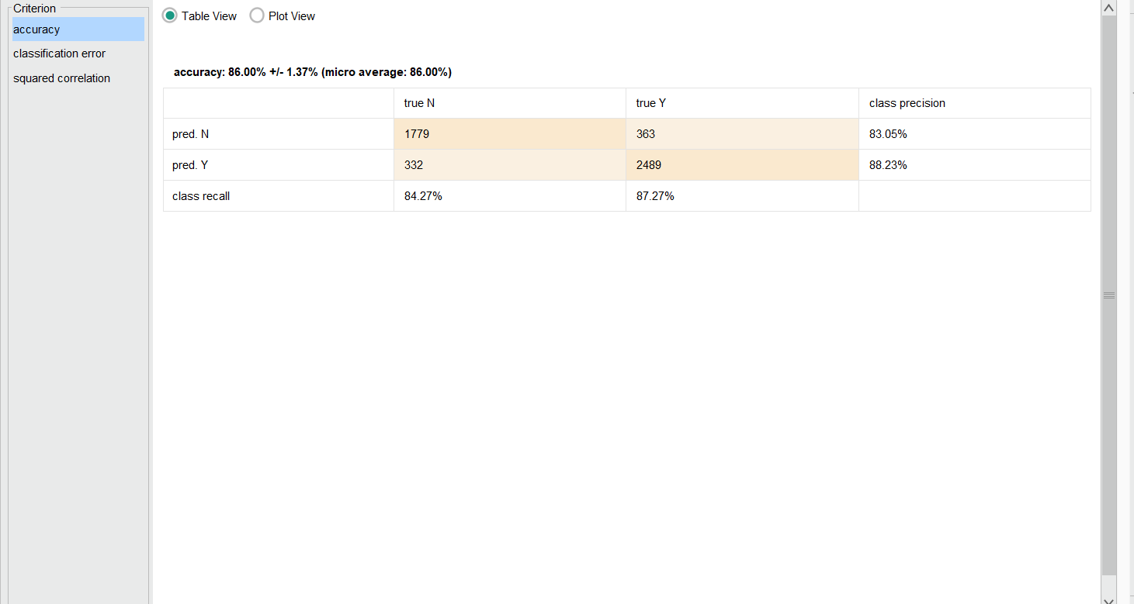
Accuracy for Combined Cases

Slide 41
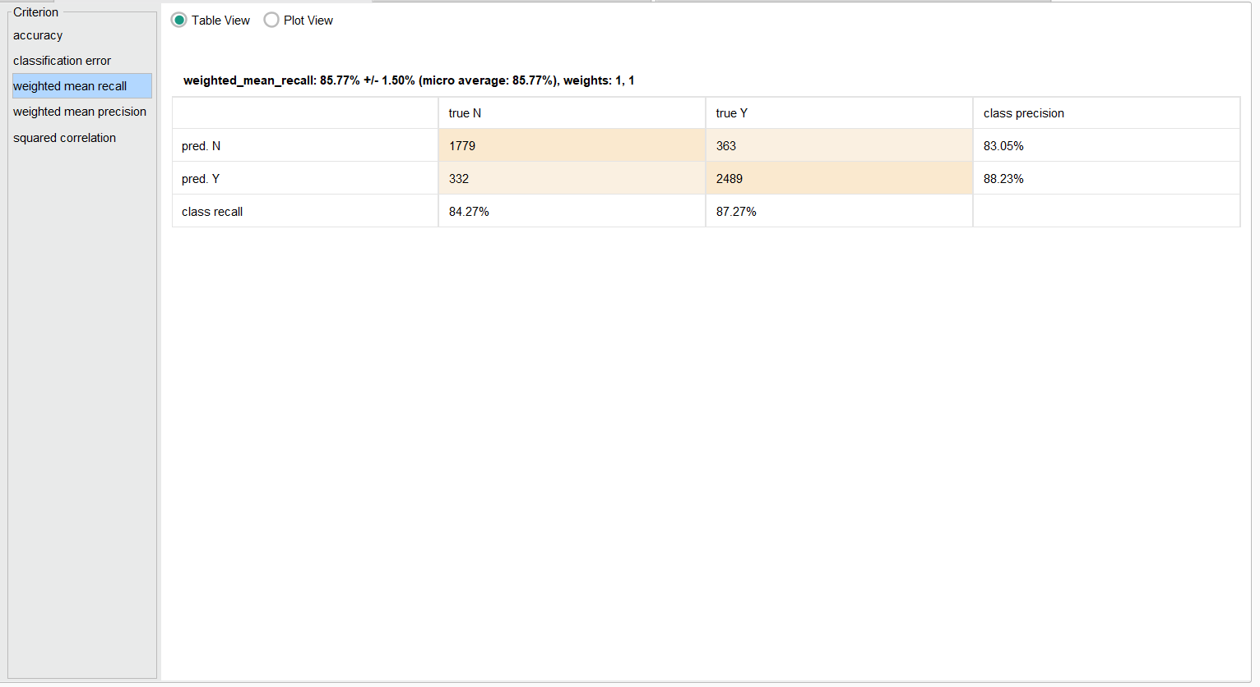
Recall Result for Combined Cases

Slide 42
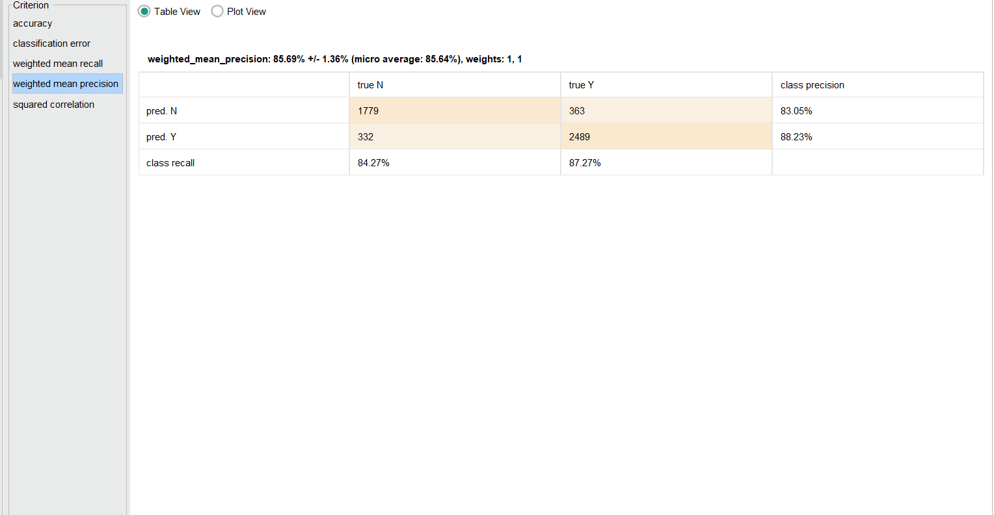
Precision Result for Combined Cases

Slide 43
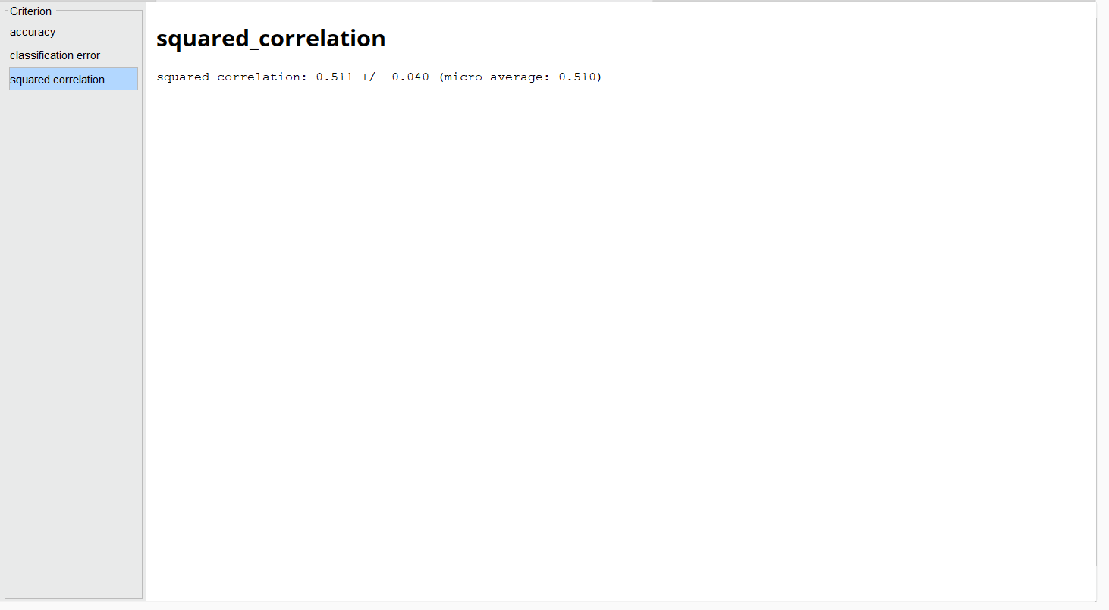
Squared Correlation

Slide 44
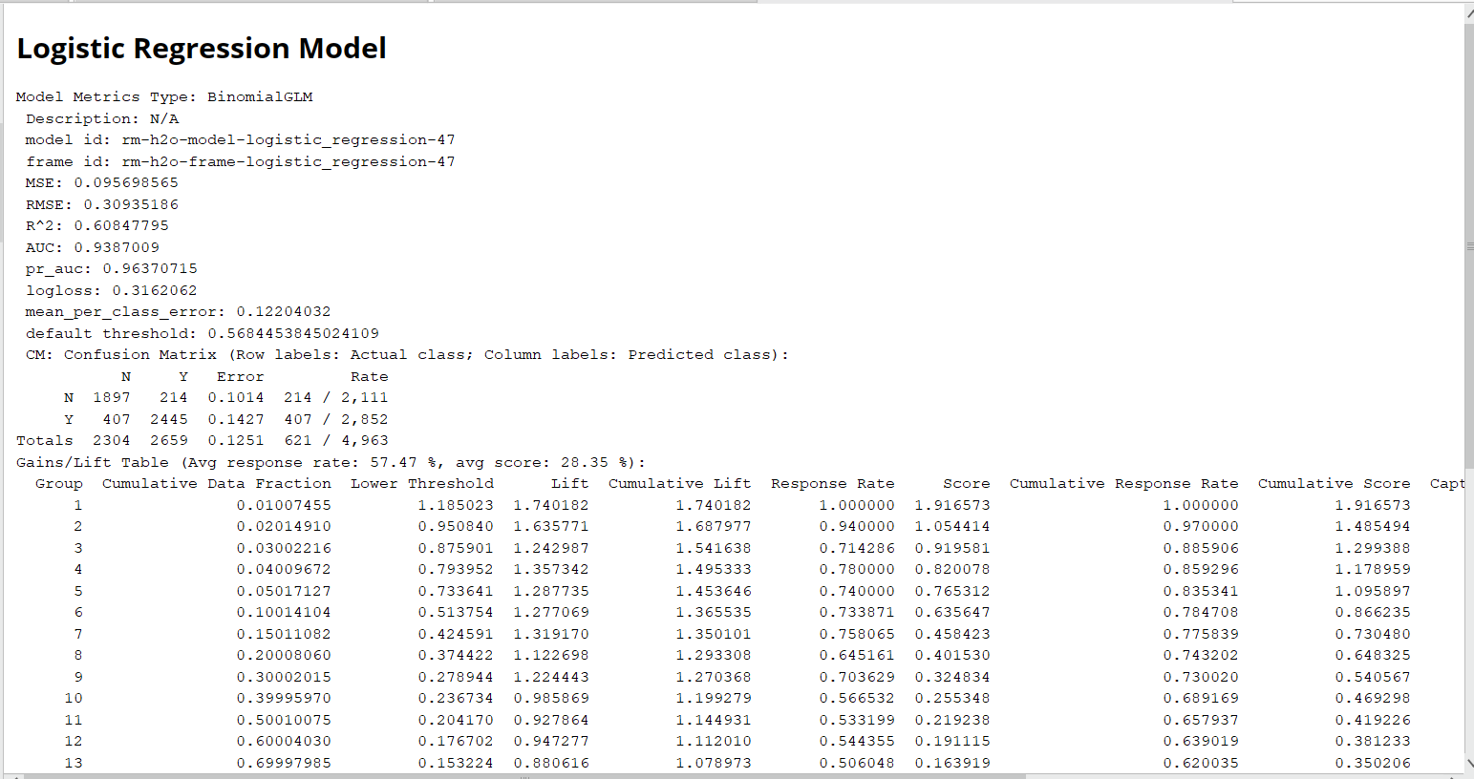
Model overview

Slide 45
Model: Decision Tree
Presented By:
Karan Gaikwad

Slide 46
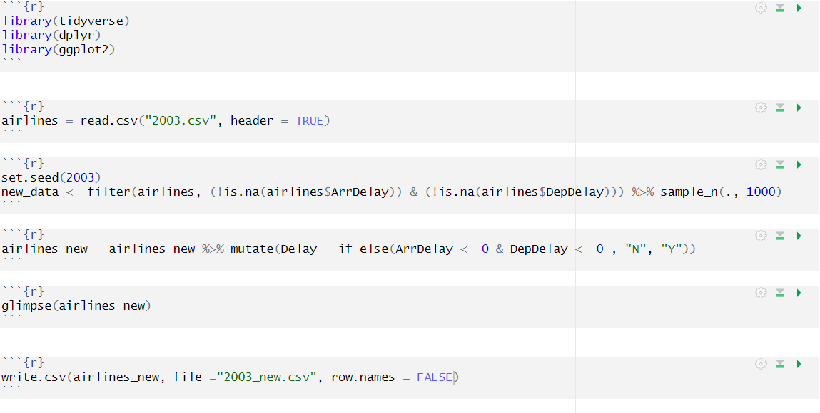
Selecting Random Data & Adding Delay Column

Slide 47
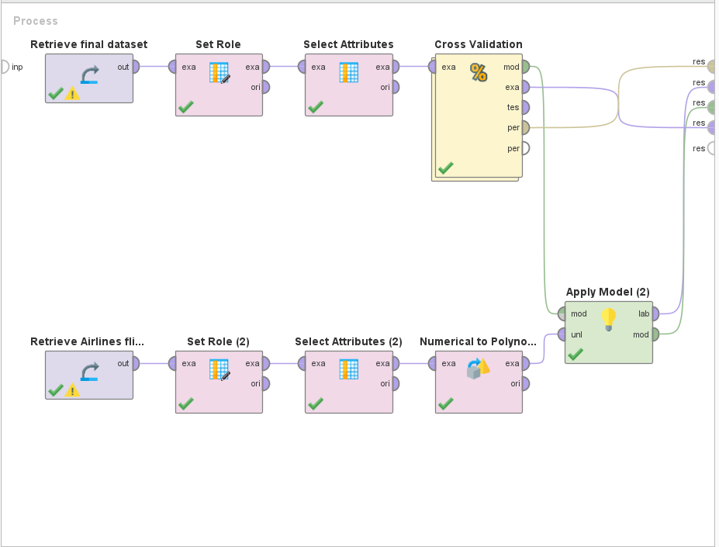
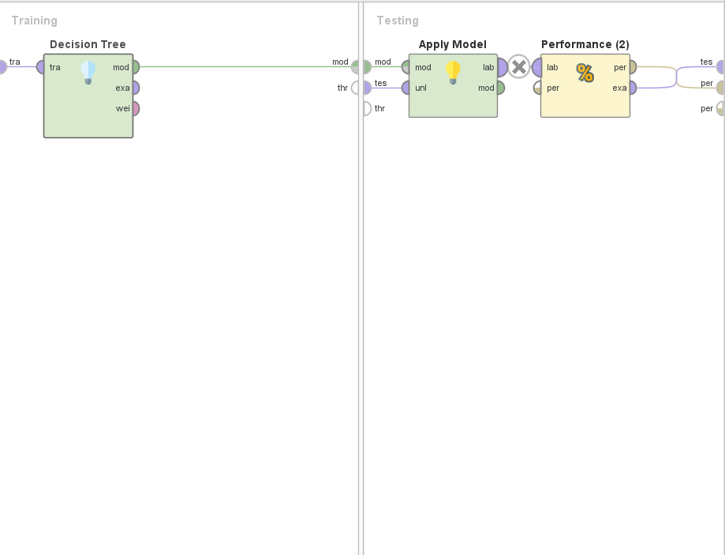
Model Designing: Decision Tree

Slide 48
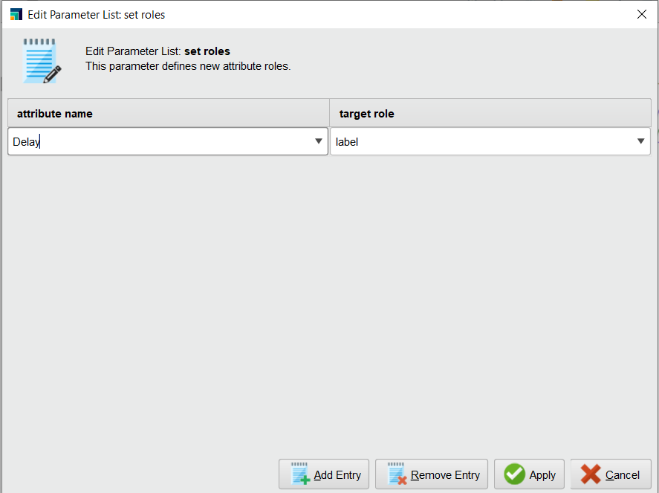
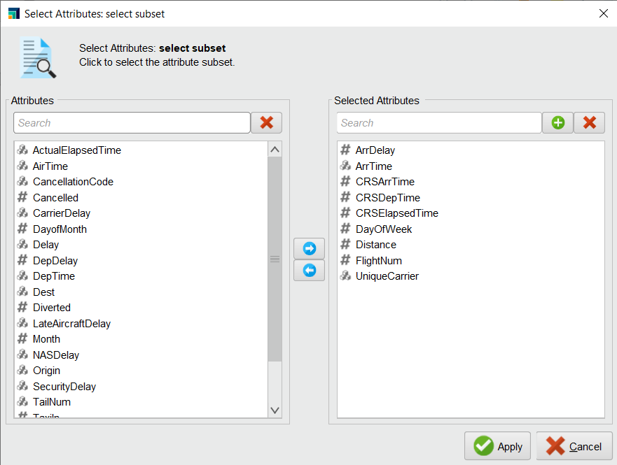
Data Pre Processing

Slide 49
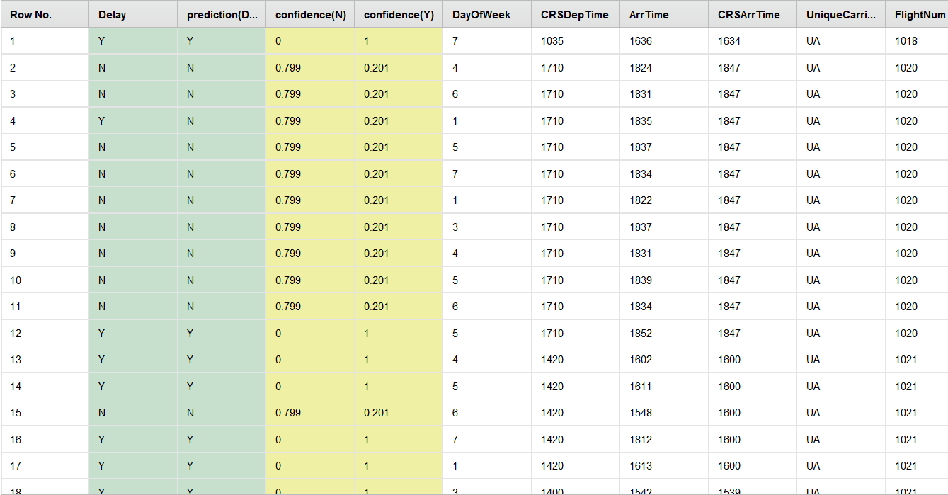
Predicition

Slide 50
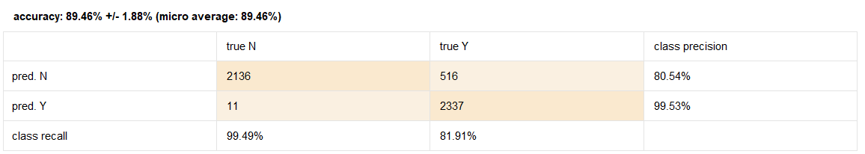
Accuracy

Slide 51
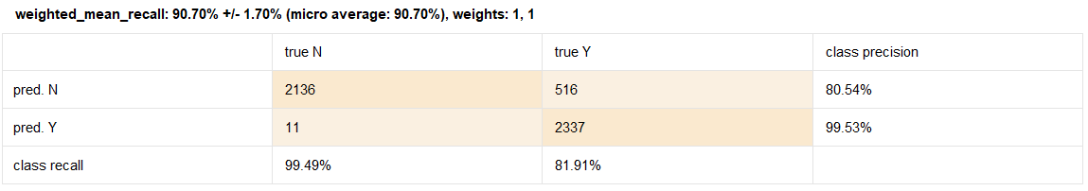

Recall
Precision

Slide 52


Decision Tree

Slide 53
Model: Random Forest
Presented By:
Sri Ram Fnu

Slide 54

Merge Data

Slide 55

Import Data in RapidMiner

Slide 56

Show Data

Slide 57


Prepare Model: Random Forest

Slide 58


Pre-process Data

Slide 59
Cross Validation

Slide 60

Random forest

Slide 61

Result: Accuracy

Slide 62


Result: Precision And Recall

Slide 63


Comparing Models

Slide 64

Model Comparison

Slide 65

Prediction for new records

Slide 66
Conclusion
Best data prediction model for the given dataset among the five model is Decision Tree.
Five Models:
Deep Learning
Decision Tree
Logistic Regression
Gradient Boosted Tree
Random Forest

